Slide 1


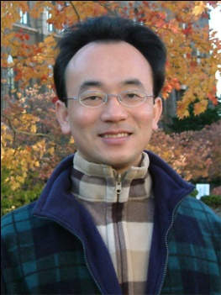
人工智慧文本分析 基礎與應用 (Artificial Intelligence for Text Analytics: Foundations and Applications)
Min-Yuh Day
戴敏育
Associate Professor
副教授
Institute of Information Management, National Taipei University
國立臺北大學 資訊管理研究所
https://web.ntpu.edu.tw/~myday
2020-09-26

Slide 2



戴敏育 博士 (Min-Yuh Day, Ph.D.)
國立台北大學 資訊管理研究所 副教授
中央研究院 資訊科學研究所 訪問學人
國立台灣大學 資訊管理 博士
Publications Co-Chairs, IEEE/ACM International Conference on Advances in Social Networks Analysis and Mining (ASONAM 2013- )
Program Co-Chair, IEEE International Workshop on Empirical Methods for Recognizing Inference in TExt (IEEE EM-RITE 2012- )
Publications Chair, The IEEE International Conference on Information Reuse and Integration (IEEE IRI)

Slide 3
Topics
自然語言處理核心技術與文字探勘 (Core Technologies of Natural Language Processing and Text Mining)
人工智慧文本分析基礎與應用 (Artificial Intelligence for Text Analytics: Foundations and Applications)
文本表達特徵工程 (Feature Engineering for Text Representation)
語意分析和命名實體識別 (Semantic Analysis and Named Entity Recognition; NER)
深度學習和通用句子嵌入模型 (Deep Learning and Universal Sentence-Embedding Models)
問答系統與對話系統 (Question Answering and Dialogue Systems)

Slide 4
Outline
AI for Text Analytics: Foundations
Processing and Understanding Text
AI for Text Analytics: Application
Sentiment Analysis
Text classification

Slide 5
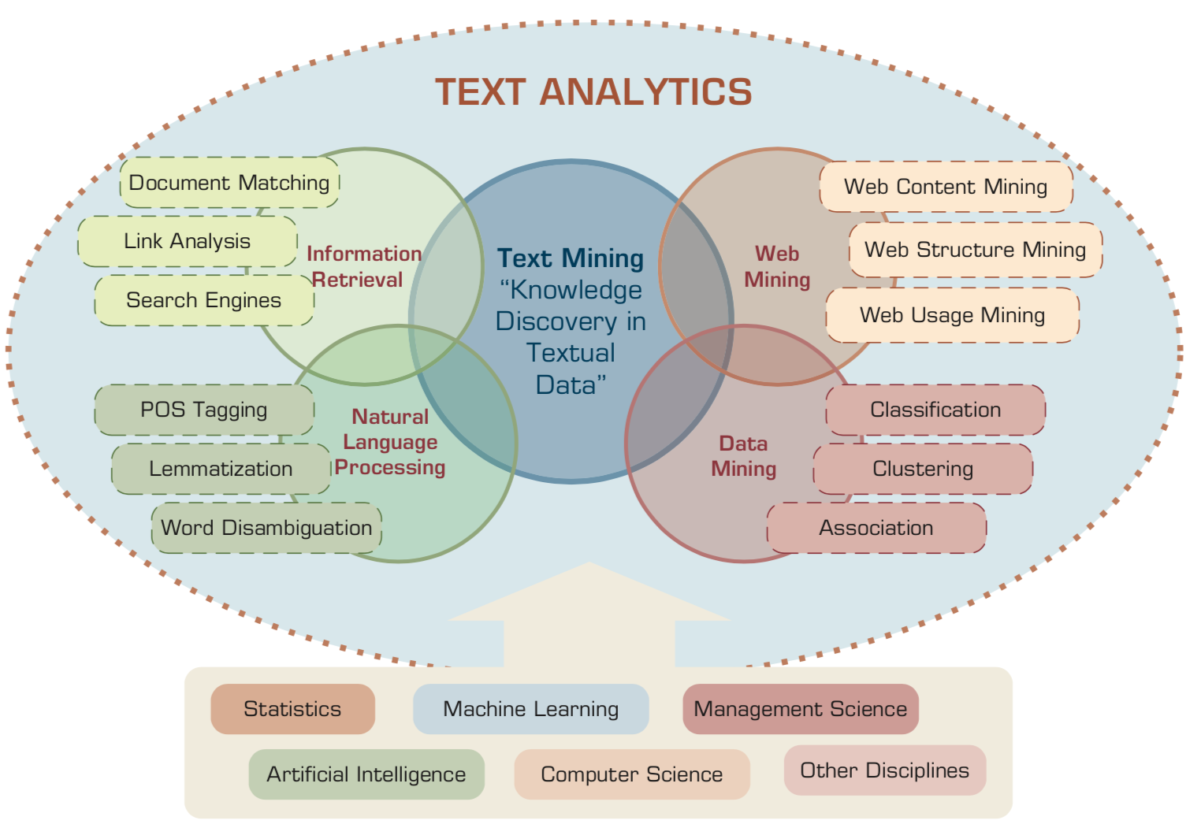
Text Analytics and Text Mining
Source: Ramesh Sharda, Dursun Delen, and Efraim Turban (2017), Business Intelligence, Analytics, and Data Science: A Managerial Perspective, 4th Edition, Pearson

Slide 6
NLP
Source: http://blog.aylien.com/leveraging-deep-learning-for-multilingual/

Slide 7
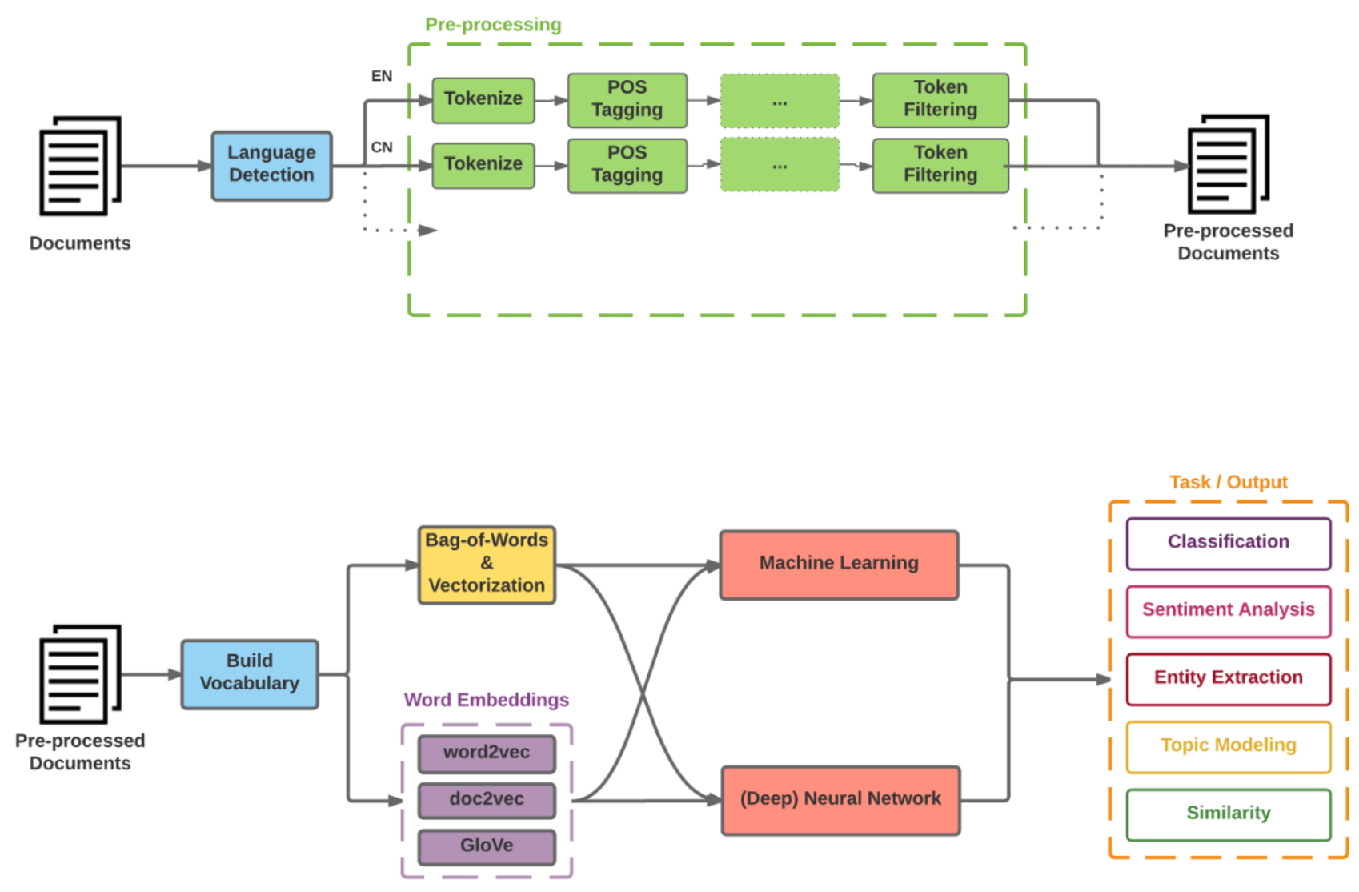
Modern NLP Pipeline
Source: https://github.com/fortiema/talks/blob/master/opendata2016sh/pragmatic-nlp-opendata2016sh.pdf

Slide 8
Modern NLP Pipeline
Source: http://mattfortier.me/2017/01/31/nlp-intro-pt-1-overview/

Slide 9
Deep Learning NLP
Source: http://mattfortier.me/2017/01/31/nlp-intro-pt-1-overview/

Slide 10
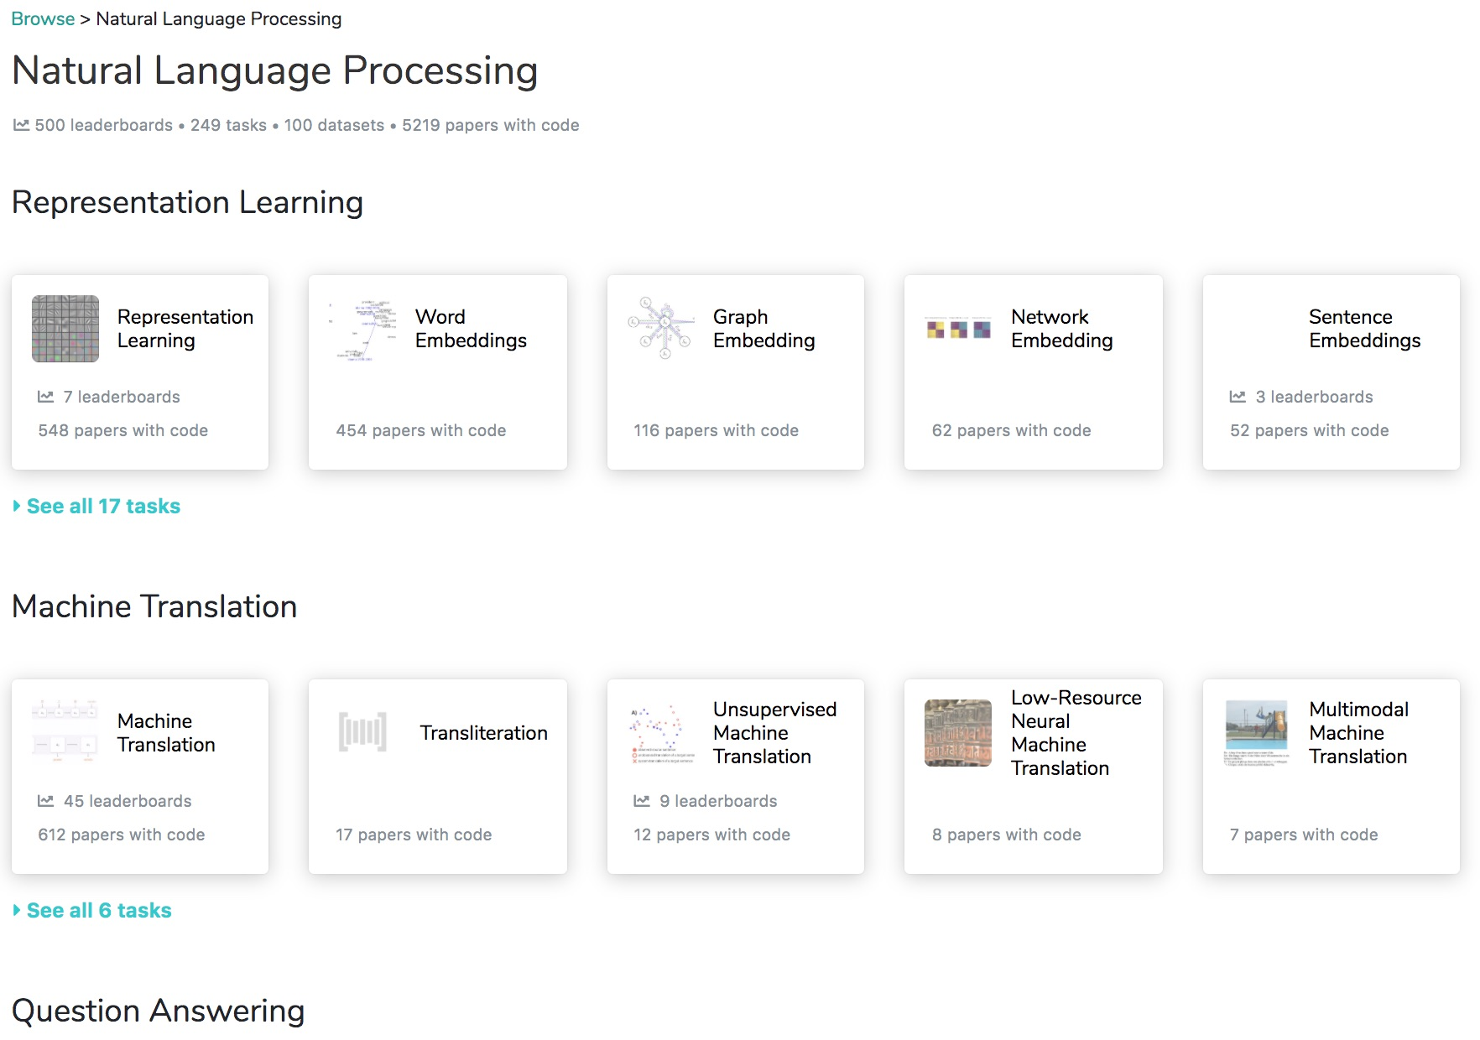
Papers with Code: NLP
https://paperswithcode.com/area/natural-language-processing

Slide 11
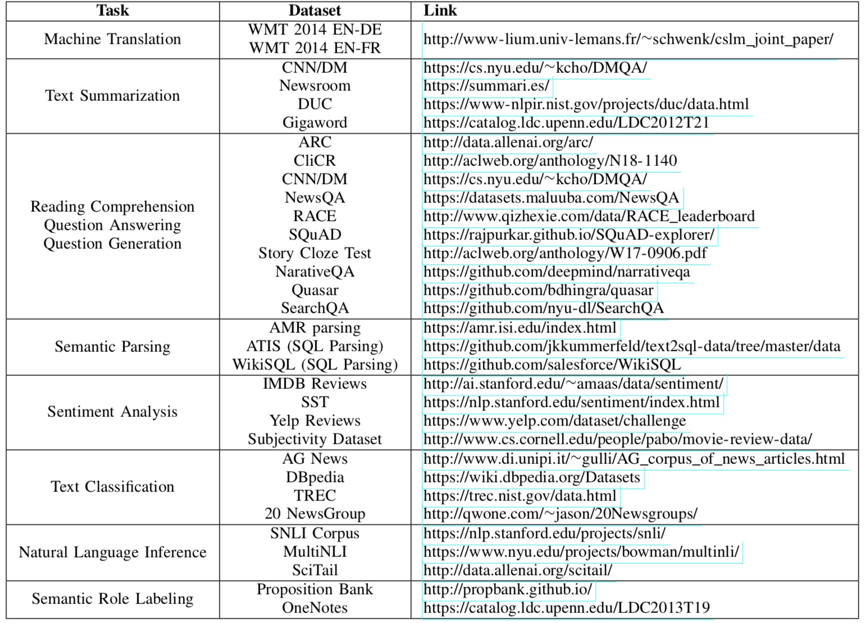
NLP Benchmark Datasets
Source: Amirsina Torfi, Rouzbeh A. Shirvani, Yaser Keneshloo, Nader Tavvaf, and Edward A. Fox (2020). "Natural Language Processing Advancements By Deep Learning: A Survey." arXiv preprint arXiv:2003.01200.

Slide 12
Processing and Understanding Text

Slide 13
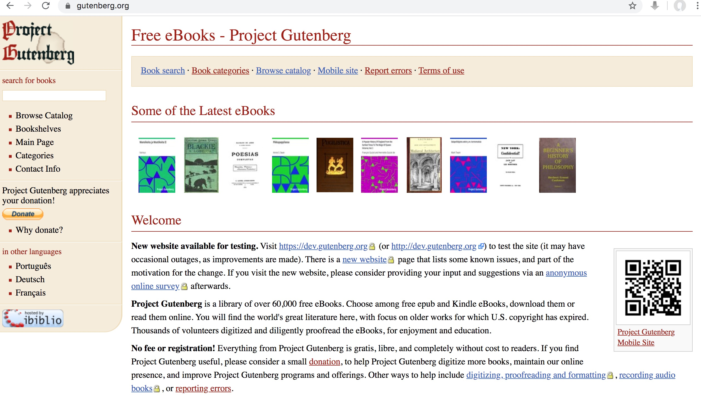
Free eBooks - Project Gutenberg
https://www.gutenberg.org/

Slide 14

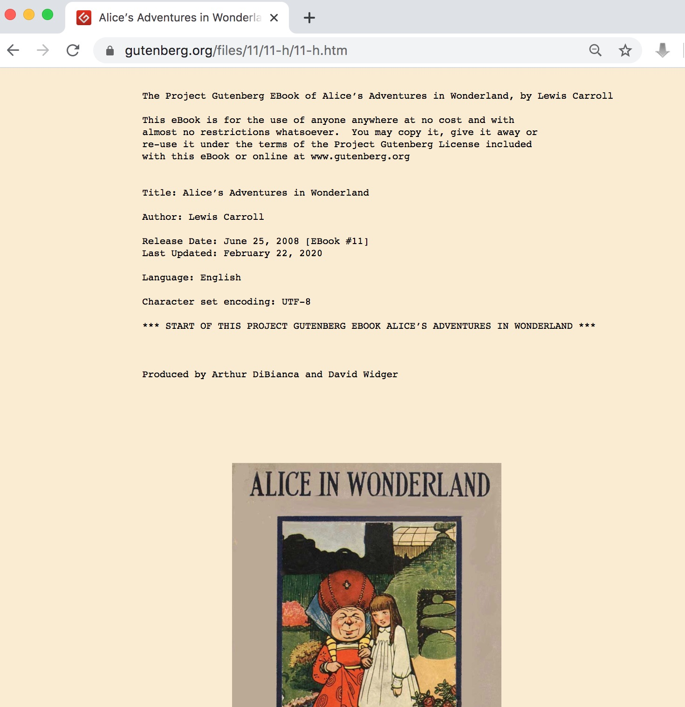
Free eBooks - Project Gutenberg Alice in Wonderland
https://www.gutenberg.org/files/11/11-h/11-h.htm

Slide 15
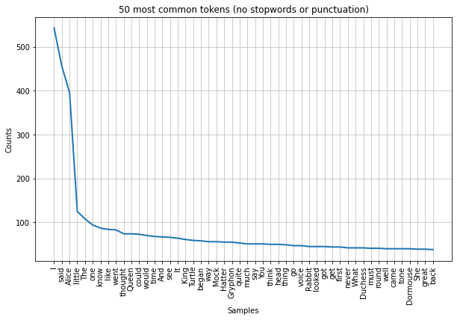
Alice Top 50 Tokens
https://tinyurl.com/aintpupython101

Slide 16
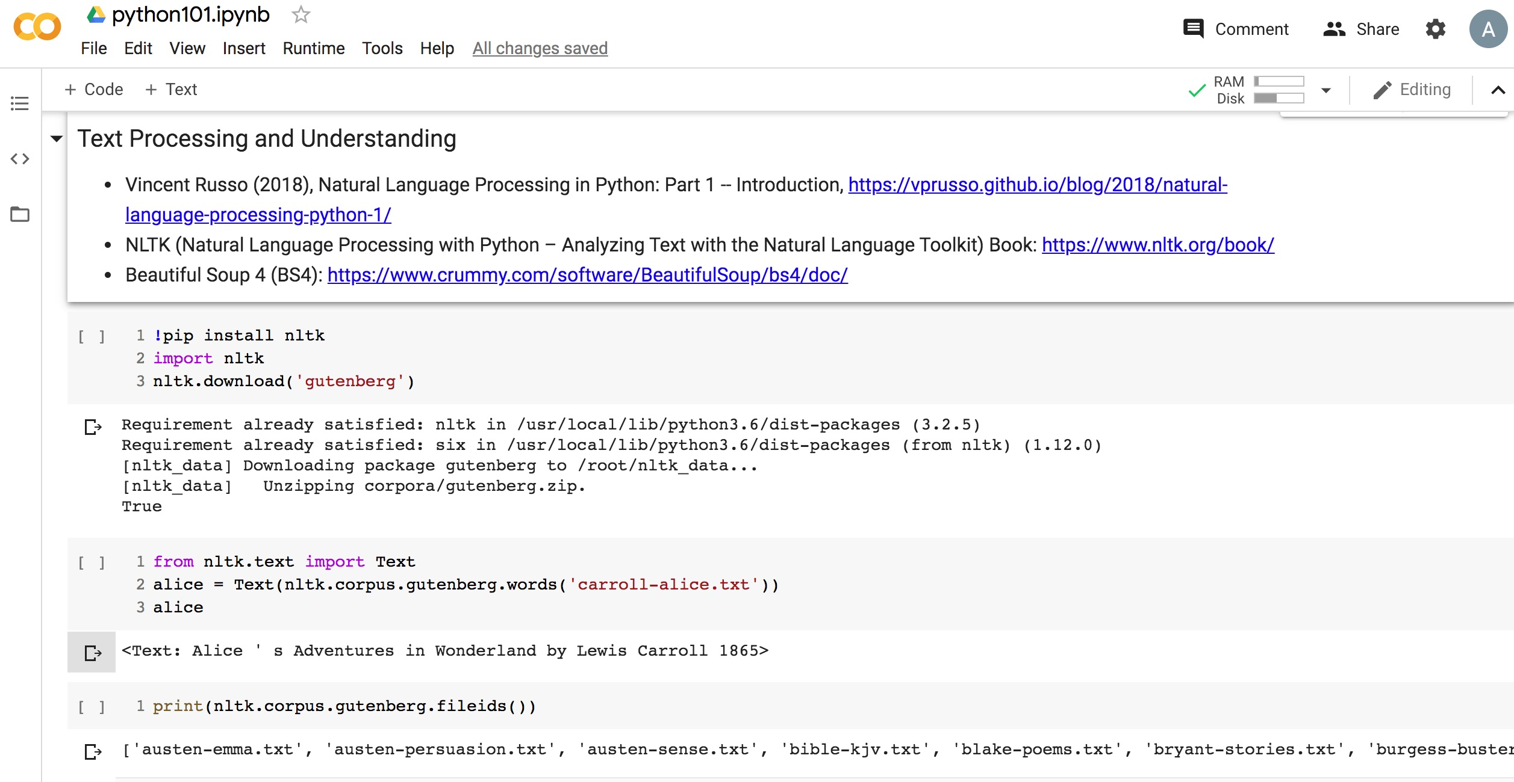
Python in Google Colab (Python101)
https://colab.research.google.com/drive/1FEG6DnGvwfUbeo4zJ1zTunjMqf2RkCrT
nltk.download('gutenberg')
alice = Text(nltk.corpus.gutenberg.words('carroll-alice.txt'))
https://tinyurl.com/aintpupython101
Notes:
!pip install nltk
import nltk
nltk.download('gutenberg')
from nltk.text import Text
alice = Text(nltk.corpus.gutenberg.words('carroll-alice.txt'))
alice

Slide 17
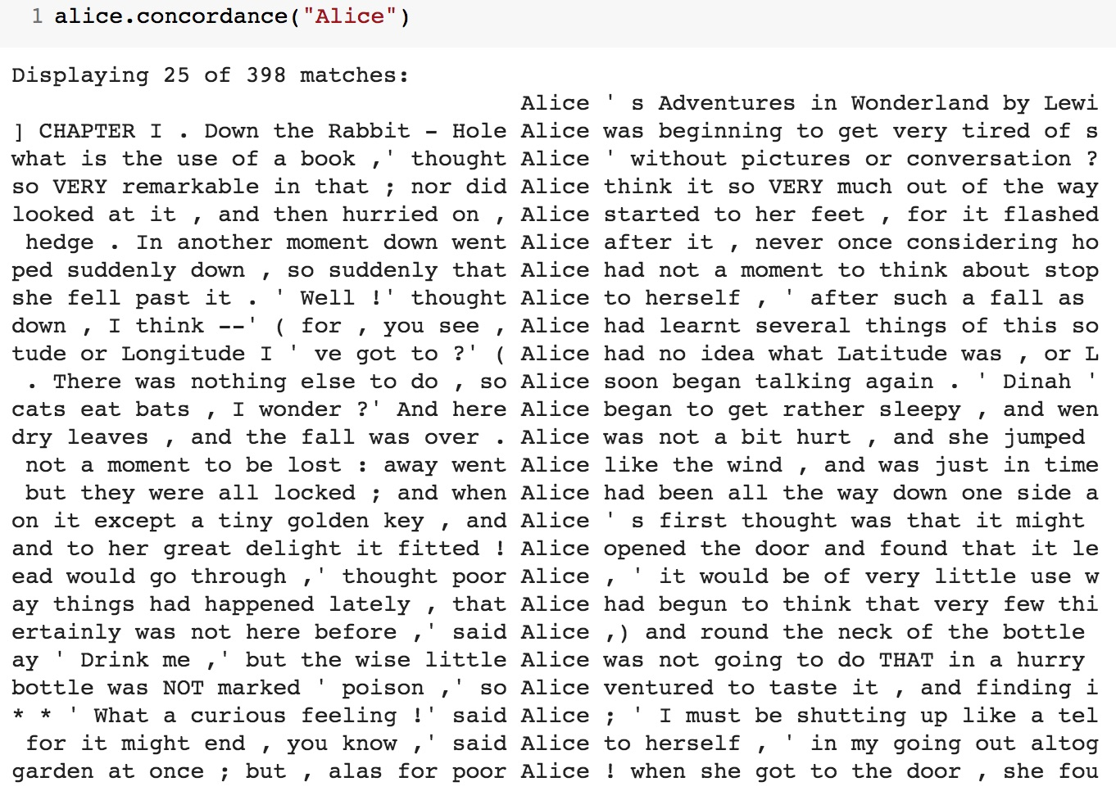
alice.concordance("Alice")
https://tinyurl.com/aintpupython101

Slide 18
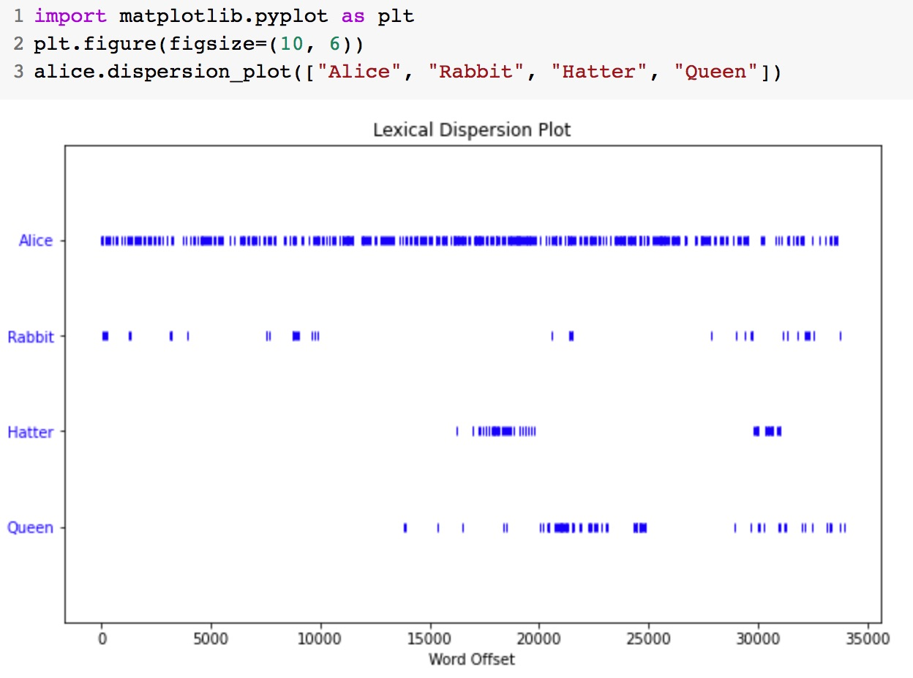
alice.dispersion_plot(["Alice", "Rabbit", "Hatter", "Queen"])
https://tinyurl.com/aintpupython101

Slide 19
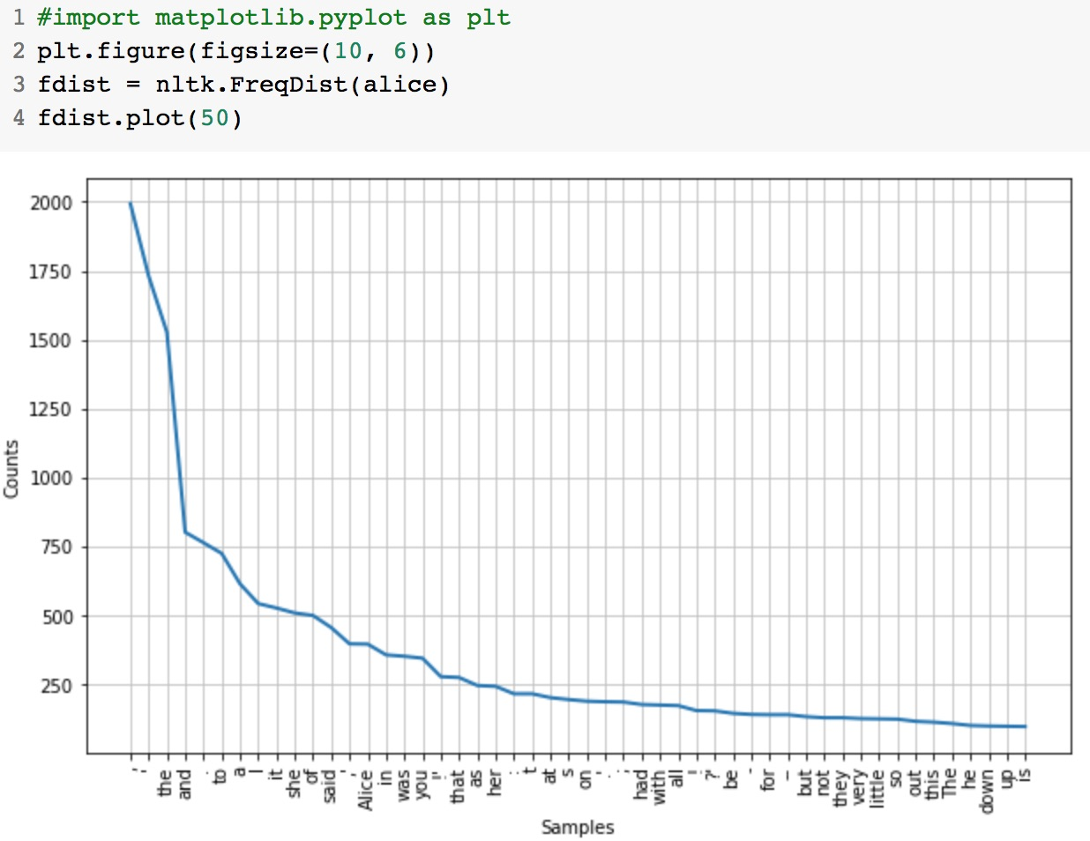
fdist = nltk.FreqDist(alice)
fdist.plot(50)
https://tinyurl.com/aintpupython101

Slide 20
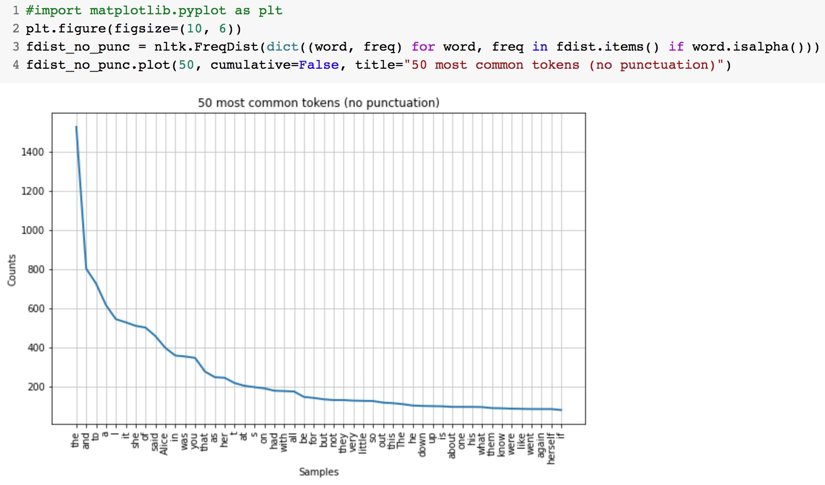
for word, freq in fdist.items() if word.isalpha()
https://tinyurl.com/aintpupython101

Slide 21
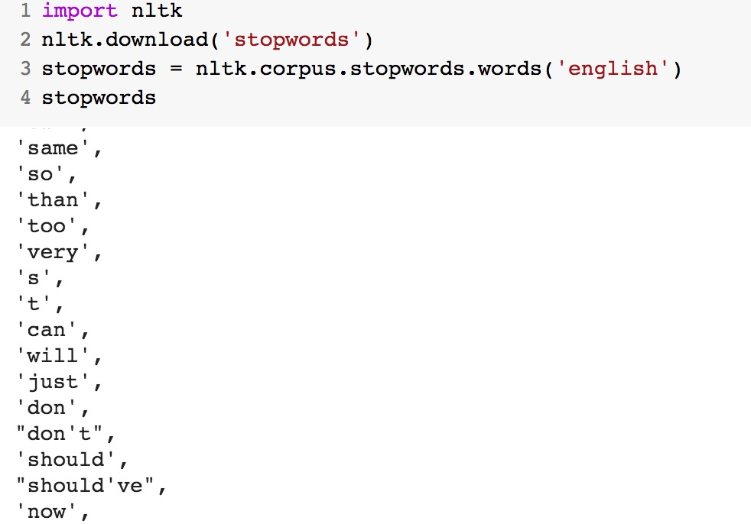
nltk.download('stopwords')
stopwords = nltk.corpus.stopwords.words('english')
https://tinyurl.com/aintpupython101

Slide 22
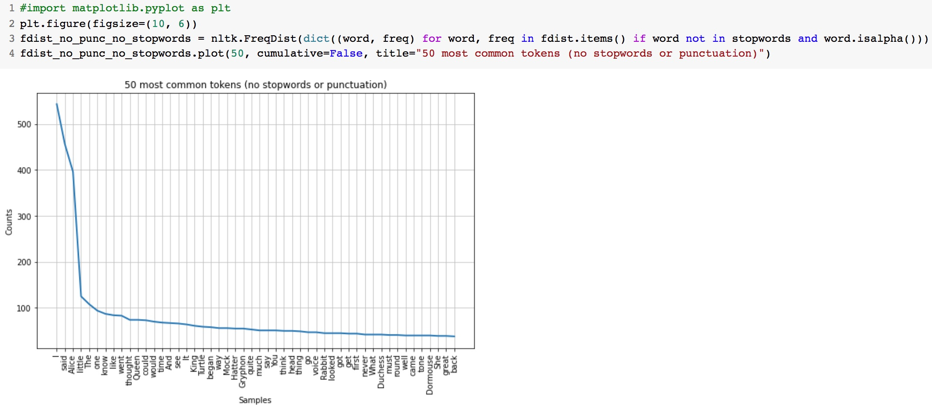
for word, freq in fdist.items() if word not in stopwords and word.isalpha()
https://tinyurl.com/aintpupython101

Slide 23
Alice Top 50 Tokens
https://tinyurl.com/aintpupython101

Slide 24
BeautifulSoup
import requests
from bs4 import BeautifulSoup
url = 'https://www.gutenberg.org/files/11/11-h/11-h.htm'
reqs = requests.get(url)
html_doc = reqs.text
soup = BeautifulSoup(html_doc, 'html.parser')
text = soup.get_text()
https://tinyurl.com/aintpupython101

Slide 25
tensorflow.keras.preprocessing.text
from tensorflow.keras.preprocessing.text import Tokenizer
sentences = [
'i love my dog',
'I, love my cat',
'You love my dog!'
]
tokenizer = Tokenizer(num_words = 100)
tokenizer.fit_on_texts(sentences)
word_index = tokenizer.word_index
print('sentences:', sentences)
print('word index:', word_index)
sentences: ['i love my dog', 'I, love my cat', 'You love my dog!’]
word index: {'love': 1, 'my': 2, 'i': 3, 'dog': 4, 'cat': 5, 'you': 6}
https://tinyurl.com/aintpupython101

Slide 26
tensorflow.keras.preprocessing.sequence import pad_sequences
import tensorflow as tf
from tensorflow import keras
from tensorflow.keras.preprocessing.text import Tokenizer
from tensorflow.keras.preprocessing.sequence import pad_sequences
sentences = [
'I love my dog',
'I love my cat',
'You love my dog!',
'Do you think my dog is amazing?’
]
tokenizer = Tokenizer(num_words = 100, oov_token="<OOV>")
tokenizer.fit_on_texts(sentences)
word_index = tokenizer.word_index sequences = tokenizer.texts_to_sequences(sentences) padded = pad_sequences(sequences, maxlen=5)
print("sentences = ", sentences)
print("Word Index = " , word_index)
print("Sequences = " , sequences)
print("Padded Sequences:")
print(padded)
https://tinyurl.com/aintpupython101

Slide 27
tensorflow.keras.preprocessing.sequence import pad_sequences
sentences = ['I love my dog', 'I love my cat', 'You love my dog!', 'Do you think my dog is amazing?’]
Word Index = {'<OOV>': 1, 'my': 2, 'love': 3, 'dog': 4, 'i': 5, 'you': 6, 'cat': 7, 'do': 8, 'think': 9, 'is': 10, 'amazing': 11}
Sequences = [[5, 3, 2, 4], [5, 3, 2, 7], [6, 3, 2, 4], [8, 6, 9, 2, 4, 10, 11]]
Padded Sequences: [[ 0 5 3 2 4] [ 0 5 3 2 7] [ 0 6 3 2 4] [ 9 2 4 10 11]]
https://tinyurl.com/aintpupython101

Slide 28
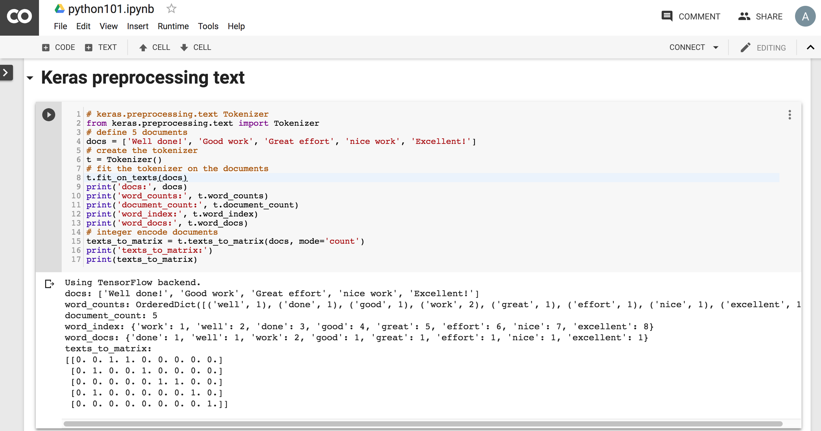
Python in Google Colab
https://colab.research.google.com/drive/1FEG6DnGvwfUbeo4zJ1zTunjMqf2RkCrT
https://tinyurl.com/aintpupython101

Slide 29
One-hot encoding
'The mouse ran up the clock’ =
[ [0, 1, 0, 0, 0, 0, 0], [0, 0, 1, 0, 0, 0, 0], [0, 0, 0, 1, 0, 0, 0], [0, 0, 0, 0, 1, 0, 0], [0, 1, 0, 0, 0, 0, 0], [0, 0, 0, 0, 0, 1, 0] ]
The mouse ran up the clock
1 2 3 4
1
5
[0, 1, 2, 3, 4, 5, 6]
Source: https://developers.google.com/machine-learning/guides/text-classification/step-3

Slide 30
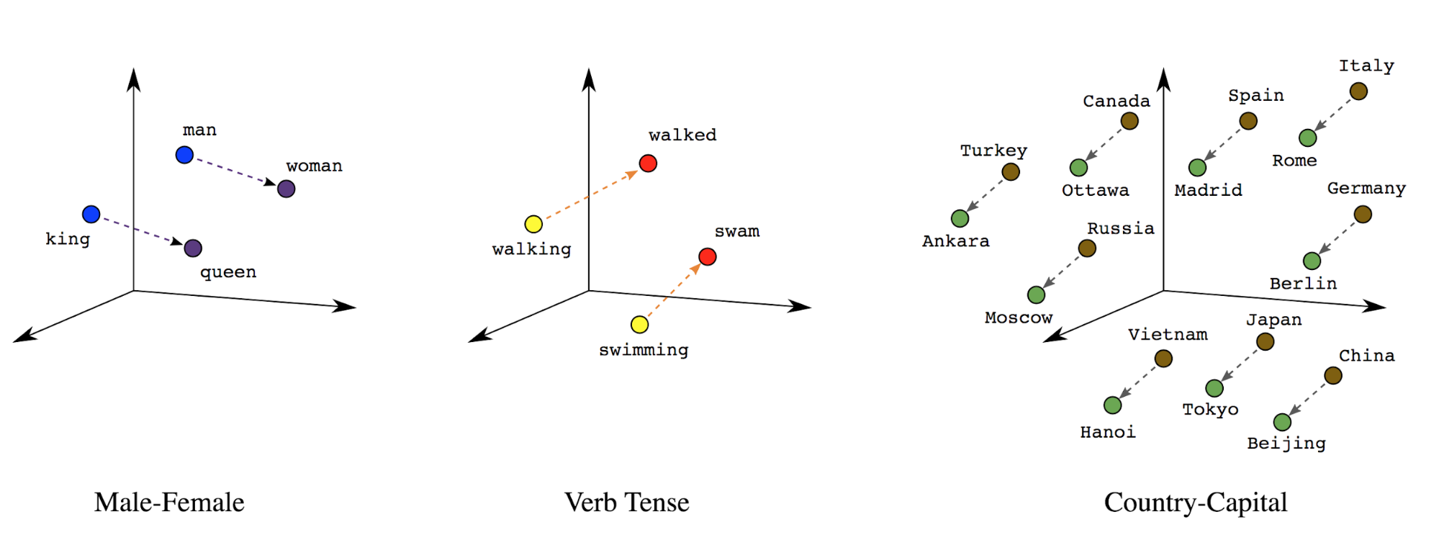
Word embeddings
Source: https://developers.google.com/machine-learning/guides/text-classification/step-3

Slide 31
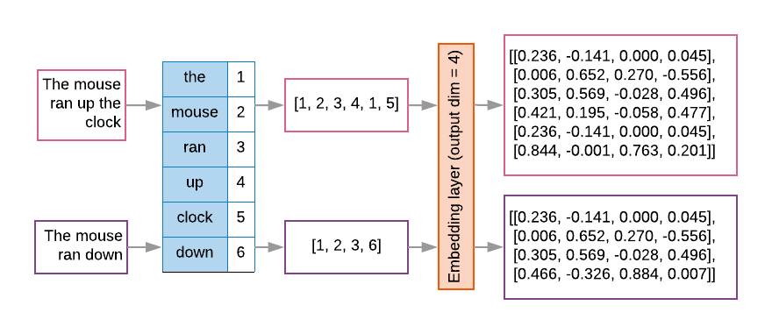
Word embeddings
Source: https://developers.google.com/machine-learning/guides/text-classification/step-3

Slide 32
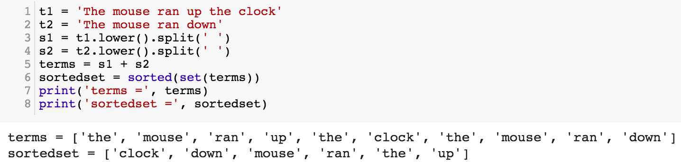
t1 = 'The mouse ran up the clock'
t2 = 'The mouse ran down'
s1 = t1.lower().split(' ')
s2 = t2.lower().split(' ')
terms = s1 + s2
sortedset = sorted(set(terms))
print('terms =', terms)
print('sortedset =', sortedset)
https://tinyurl.com/aintpupython101
Notes:
t1 = 'The mouse ran up the clock'
t2 = 'The mouse ran down'
s1 = t1.lower().split(' ')
s2 = t2.lower().split(' ')
terms = s1 + s2
sortedset = sorted(set(terms))
print('terms =', terms)
print('sortedset =', sortedset)

Slide 33
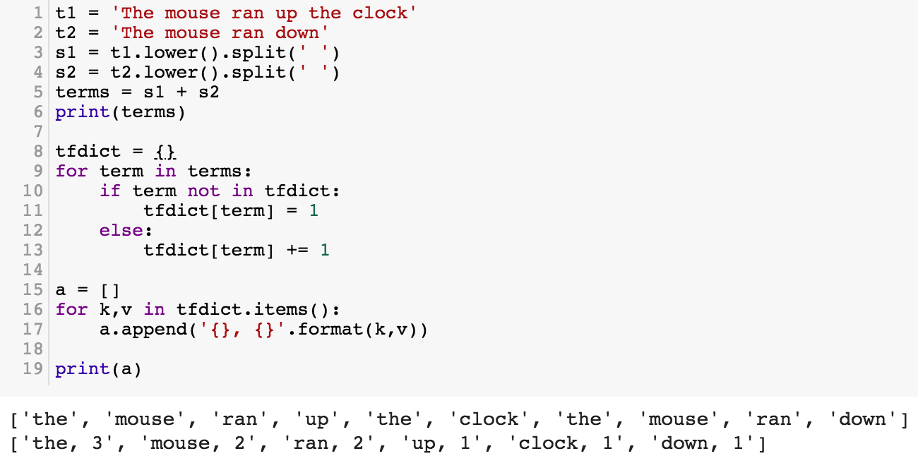
t1 = 'The mouse ran up the clock'
t2 = 'The mouse ran down'
s1 = t1.lower().split(' ')
s2 = t2.lower().split(' ')
terms = s1 + s2
print(terms)
tfdict = {}
for term in terms:
if term not in tfdict:
tfdict[term] = 1
else:
tfdict[term] += 1
a = []
for k,v in tfdict.items():
a.append('{}, {}'.format(k,v))
print(a)
https://tinyurl.com/aintpupython101

Slide 34
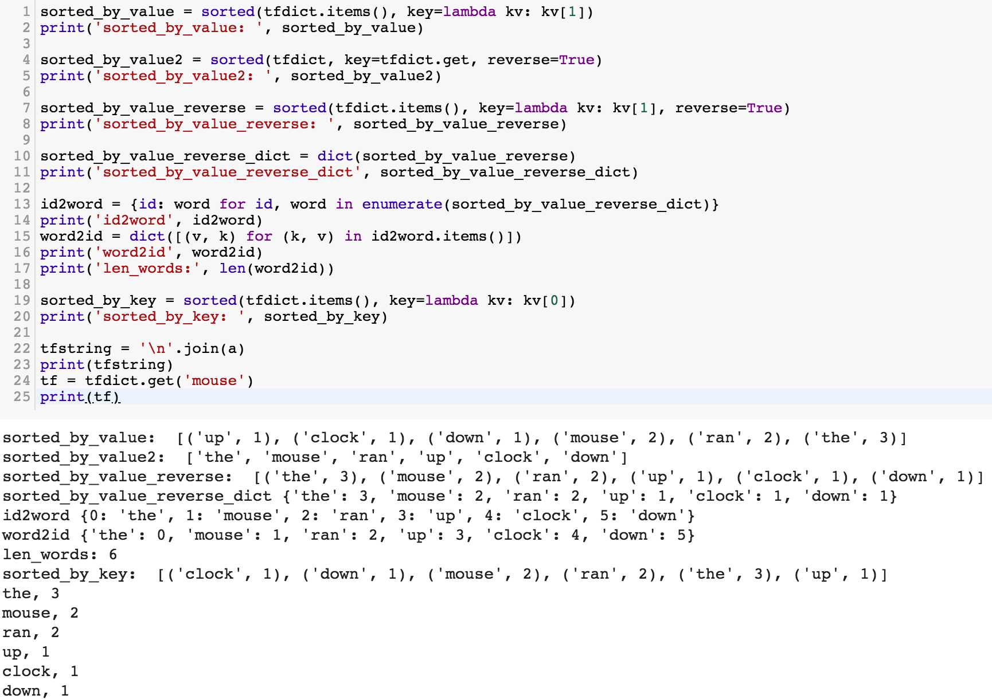
sorted_by_value_reverse = sorted(tfdict.items(), key=lambda kv: kv[1], reverse=True)
sorted_by_value_reverse_dict = dict(sorted_by_value_reverse)
id2word = {id: word for id, word in enumerate(sorted_by_value_reverse_dict)}
word2id = dict([(v, k) for (k, v) in id2word.items()])
https://tinyurl.com/aintpupython101

Slide 35
sorted_by_value = sorted(tfdict.items(), key=lambda kv: kv[1])
print('sorted_by_value: ', sorted_by_value)
sorted_by_value2 = sorted(tfdict, key=tfdict.get, reverse=True)
print('sorted_by_value2: ', sorted_by_value2)
sorted_by_value_reverse = sorted(tfdict.items(), key=lambda kv: kv[1], reverse=True)
print('sorted_by_value_reverse: ', sorted_by_value_reverse)
sorted_by_value_reverse_dict = dict(sorted_by_value_reverse)
print('sorted_by_value_reverse_dict', sorted_by_value_reverse_dict)
id2word = {id: word for id, word in enumerate(sorted_by_value_reverse_dict)}
print('id2word', id2word)
word2id = dict([(v, k) for (k, v) in id2word.items()])
print('word2id', word2id)
print('len_words:', len(word2id))
sorted_by_key = sorted(tfdict.items(), key=lambda kv: kv[0])
print('sorted_by_key: ', sorted_by_key)
tfstring = '\n'.join(a)
print(tfstring)
tf = tfdict.get('mouse')
print(tf)
https://tinyurl.com/aintpupython101

Slide 36
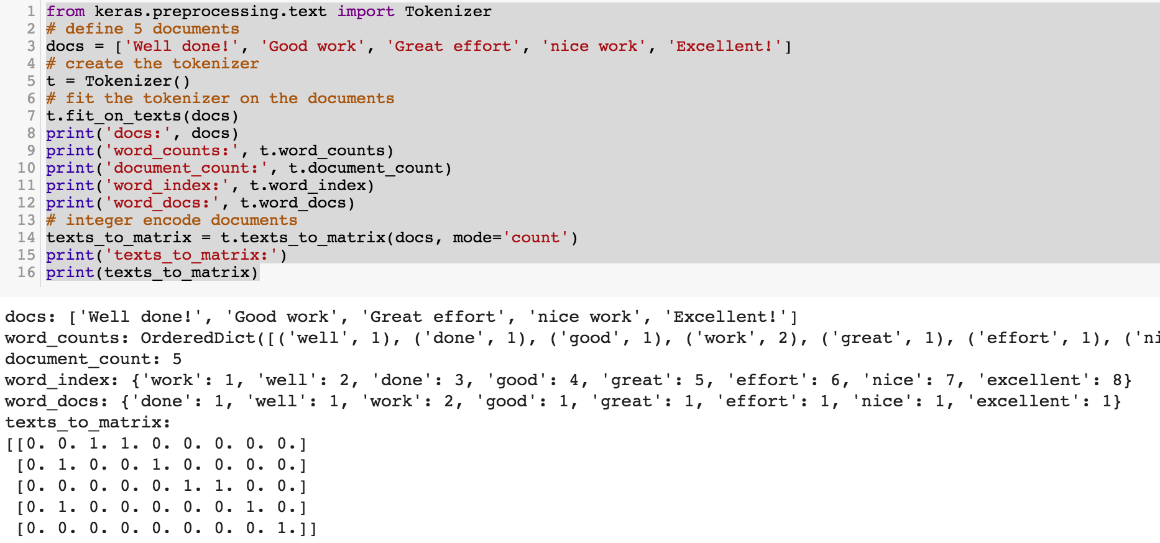
from keras.preprocessing.text import Tokenizer
Source: https://machinelearningmastery.com/prepare-text-data-deep-learning-keras/
Notes:
from keras.preprocessing.text import Tokenizer
# define 5 documents
docs = ['Well done!', 'Good work', 'Great effort', 'nice work', 'Excellent!']
# create the tokenizer
t = Tokenizer()
# fit the tokenizer on the documents
t.fit_on_texts(docs)
print('docs:', docs)
print('word_counts:', t.word_counts)
print('document_count:', t.document_count)
print('word_index:', t.word_index)
print('word_docs:', t.word_docs)
# integer encode documents
texts_to_matrix = t.texts_to_matrix(docs, mode='count')
print('texts_to_matrix:')
print(texts_to_matrix)

Slide 37
from keras.preprocessing.text import Tokenizer
from keras.preprocessing.text import Tokenizer
# define 5 documents
docs = ['Well done!', 'Good work', 'Great effort', 'nice work', 'Excellent!']
# create the tokenizer
t = Tokenizer()
# fit the tokenizer on the documents
t.fit_on_texts(docs)
print('docs:', docs)
print('word_counts:', t.word_counts)
print('document_count:', t.document_count)
print('word_index:', t.word_index)
print('word_docs:', t.word_docs)
# integer encode documents
texts_to_matrix = t.texts_to_matrix(docs, mode='count')
print('texts_to_matrix:')
print(texts_to_matrix)
Source: https://machinelearningmastery.com/prepare-text-data-deep-learning-keras/

Slide 38
texts_to_matrix = t.texts_to_matrix(docs, mode='count')
docs: ['Well done!', 'Good work', 'Great effort’, 'nice work', 'Excellent!’]
word_counts: OrderedDict([('well', 1), ('done', 1), ('good', 1), ('work', 2), ('great', 1), ('effort', 1), ('nice', 1), ('excellent', 1)])
document_count: 5
word_index: {'work': 1, 'well': 2, 'done': 3, 'good': 4, 'great': 5, 'effort': 6, 'nice': 7, 'excellent': 8}
word_docs: {'done': 1, 'well': 1, 'work': 2, 'good': 1, 'great': 1, 'effort': 1, 'nice': 1, 'excellent': 1}
texts_to_matrix: [[0. 0. 1. 1. 0. 0. 0. 0. 0.] [0. 1. 0. 0. 1. 0. 0. 0. 0.] [0. 0. 0. 0. 0. 1. 1. 0. 0.] [0. 1. 0. 0. 0. 0. 0. 1. 0.] [0. 0. 0. 0. 0. 0. 0. 0. 1.]]
Source: https://machinelearningmastery.com/prepare-text-data-deep-learning-keras/
Notes:
from keras.preprocessing.text import Tokenizer
# define 5 documents
docs = ['Well done!', 'Good work', 'Great effort', 'nice work', 'Excellent!']
# create the tokenizer
t = Tokenizer()
# fit the tokenizer on the documents
t.fit_on_texts(docs)
print('docs:', docs)
print('word_counts:', t.word_counts)
print('document_count:', t.document_count)
print('word_index:', t.word_index)
print('word_docs:', t.word_docs)
# integer encode documents
texts_to_matrix = t.texts_to_matrix(docs, mode='count')
print('texts_to_matrix:')
print(texts_to_matrix)

Slide 39
t.texts_to_matrix(docs, mode='tfidf')
from keras.preprocessing.text import Tokenizer
# define 5 documents
docs = ['Well done!', 'Good work', 'Great effort', 'nice work', 'Excellent!']
# create the tokenizer
t = Tokenizer()
# fit the tokenizer on the documents
t.fit_on_texts(docs)
print('docs:', docs)
print('word_counts:', t.word_counts)
print('document_count:', t.document_count)
print('word_index:', t.word_index)
print('word_docs:', t.word_docs)
# integer encode documents
texts_to_matrix = t.texts_to_matrix(docs, mode='tfidf')
print('texts_to_matrix:')
print(texts_to_matrix)
texts_to_matrix: [[0. 0. 1.25276297 1.25276297 0. 0. 0. 0. 0. ] [0. 0.98082925 0. 0. 1.25276297 0. 0. 0. 0. ] [0. 0. 0. 0. 0. 1.25276297 1.25276297 0. 0. ] [0. 0.98082925 0. 0. 0. 0. 0. 1.25276297 0. ] [0. 0. 0. 0. 0. 0. 0. 0. 1.25276297]]
Source: https://machinelearningmastery.com/prepare-text-data-deep-learning-keras/
Notes:
from keras.preprocessing.text import Tokenizer
# define 5 documents
docs = ['Well done!', 'Good work', 'Great effort', 'nice work', 'Excellent!']
# create the tokenizer
t = Tokenizer()
# fit the tokenizer on the documents
t.fit_on_texts(docs)
print('docs:', docs)
print('word_counts:', t.word_counts)
print('document_count:', t.document_count)
print('word_index:', t.word_index)
print('word_docs:', t.word_docs)
# integer encode documents
texts_to_matrix = t.texts_to_matrix(docs, mode='tfidf')
print('texts_to_matrix:')
print(texts_to_matrix)
###########
‘’’
docs: ['Well done!', 'Good work', 'Great effort', 'nice work', 'Excellent!'] word_counts: OrderedDict([('well', 1), ('done', 1), ('good', 1), ('work', 2), ('great', 1), ('effort', 1), ('nice', 1), ('excellent', 1)]) document_count: 5 word_index: {'work': 1, 'well': 2, 'done': 3, 'good': 4, 'great': 5, 'effort': 6, 'nice': 7, 'excellent': 8} word_docs: {'done': 1, 'well': 1, 'work': 2, 'good': 1, 'great': 1, 'effort': 1, 'nice': 1, 'excellent': 1} texts_to_matrix: [[0. 0. 1.25276297 1.25276297 0. 0. 0. 0. 0. ] [0. 0.98082925 0. 0. 1.25276297 0. 0. 0. 0. ] [0. 0. 0. 0. 0. 1.25276297 1.25276297 0. 0. ] [0. 0.98082925 0. 0. 0. 0. 0. 1.25276297 0. ] [0. 0. 0. 0. 0. 0. 0. 0. 1.25276297]]
‘’’

Slide 40
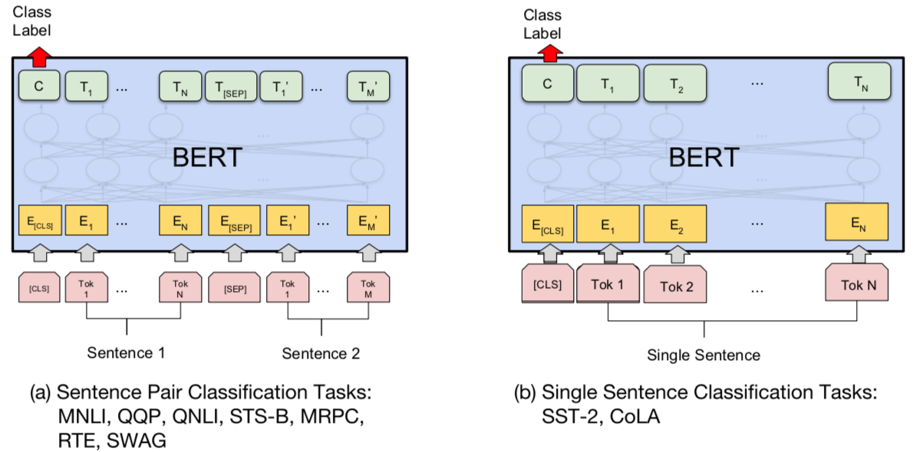
BERT Sequence-level tasks
Source: Devlin, Jacob, Ming-Wei Chang, Kenton Lee, and Kristina Toutanova (2018). "BERT: Pre-training of Deep Bidirectional Transformers for Language Understanding." arXiv preprint arXiv:1810.04805

Slide 41
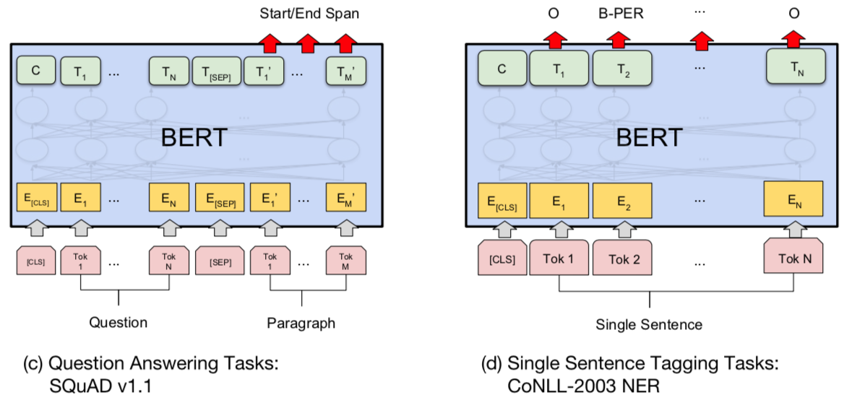
BERT Token-level tasks
Source: Devlin, Jacob, Ming-Wei Chang, Kenton Lee, and Kristina Toutanova (2018). "BERT: Pre-training of Deep Bidirectional Transformers for Language Understanding." arXiv preprint arXiv:1810.04805

Slide 42
Sentiment Analysis: Single Sentence Classification
Source: Devlin, Jacob, Ming-Wei Chang, Kenton Lee, and Kristina Toutanova (2018). "BERT: Pre-training of Deep Bidirectional Transformers for Language Understanding." arXiv preprint arXiv:1810.04805

Slide 43
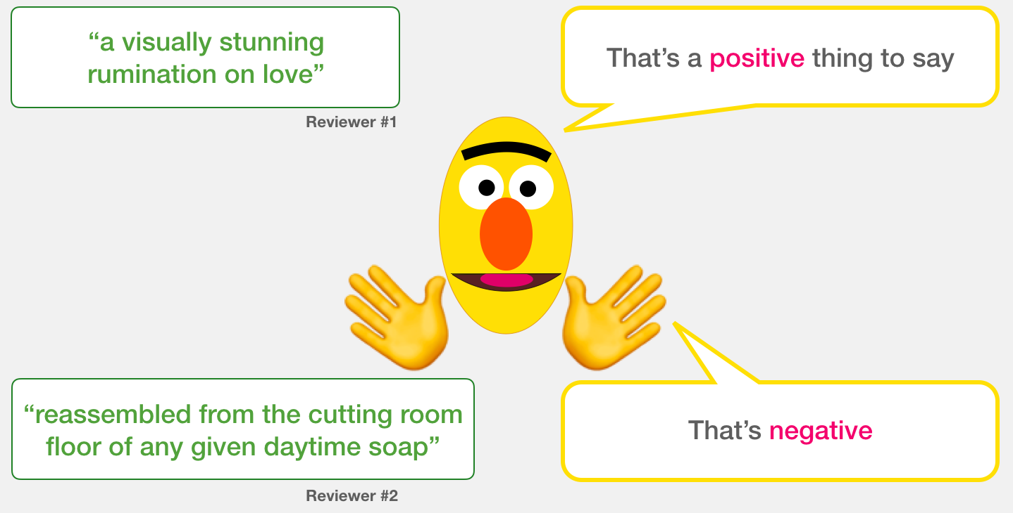
A Visual Guide to Using BERT for the First Time (Jay Alammar, 2019)
Source: Jay Alammar (2019), A Visual Guide to Using BERT for the First Time, http://jalammar.github.io/a-visual-guide-to-using-bert-for-the-first-time/

Slide 44
Sentiment Classification: SST2 Sentences from movie reviews
sentence | label
a stirring , funny and finally transporting re imagining of beauty and the beast and 1930s horror films | 1
apparently reassembled from the cutting room floor of any given daytime soap | 0
they presume their audience won't sit still for a sociology lesson | 0
this is a visually stunning rumination on love , memory , history and the war between art and commerce | 1
jonathan parker 's bartleby should have been the be all end all of the modern office anomie films | 1
Source: Jay Alammar (2019), A Visual Guide to Using BERT for the First Time, http://jalammar.github.io/a-visual-guide-to-using-bert-for-the-first-time/

Slide 45
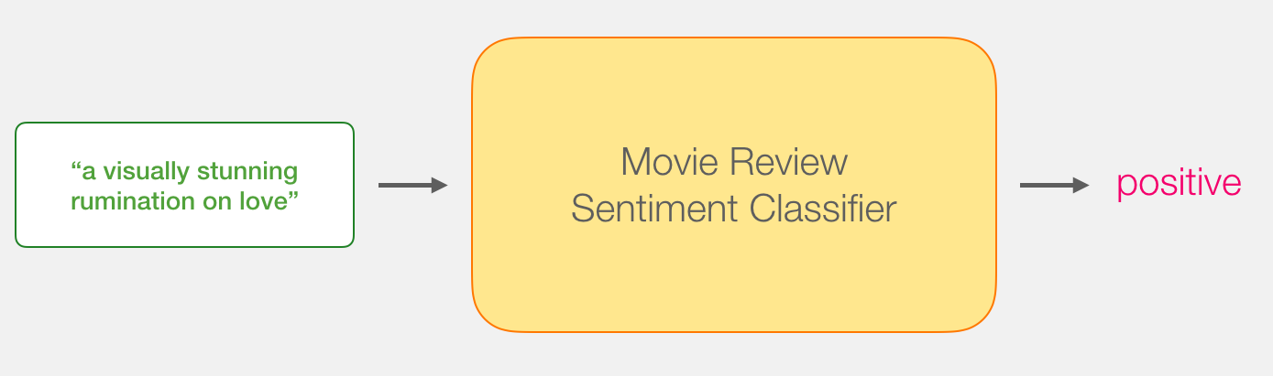
Movie Review Sentiment Classifier
Source: Jay Alammar (2019), A Visual Guide to Using BERT for the First Time, http://jalammar.github.io/a-visual-guide-to-using-bert-for-the-first-time/

Slide 46
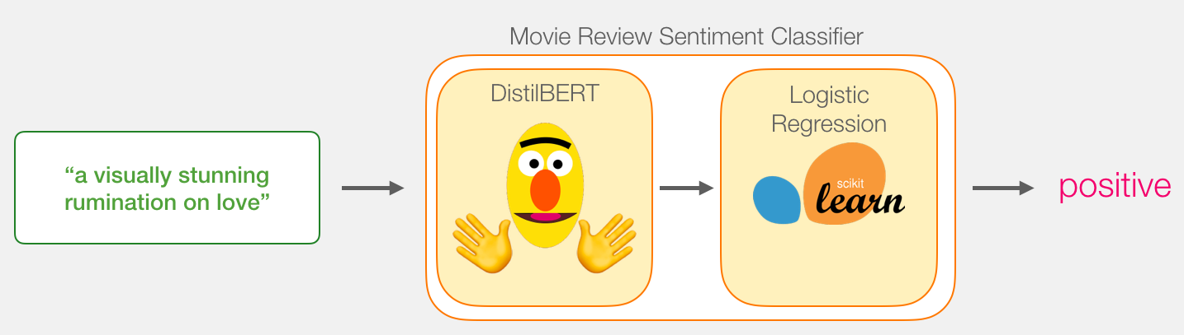
Movie Review Sentiment Classifier
Source: Jay Alammar (2019), A Visual Guide to Using BERT for the First Time, http://jalammar.github.io/a-visual-guide-to-using-bert-for-the-first-time/

Slide 47
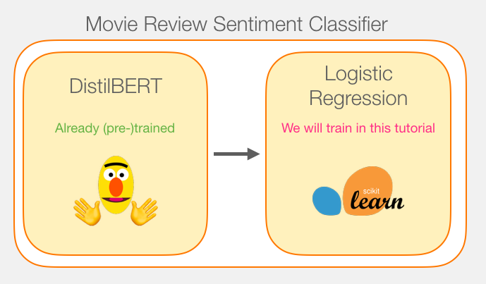
Movie Review Sentiment Classifier Model Training
Source: Jay Alammar (2019), A Visual Guide to Using BERT for the First Time, http://jalammar.github.io/a-visual-guide-to-using-bert-for-the-first-time/

Slide 48
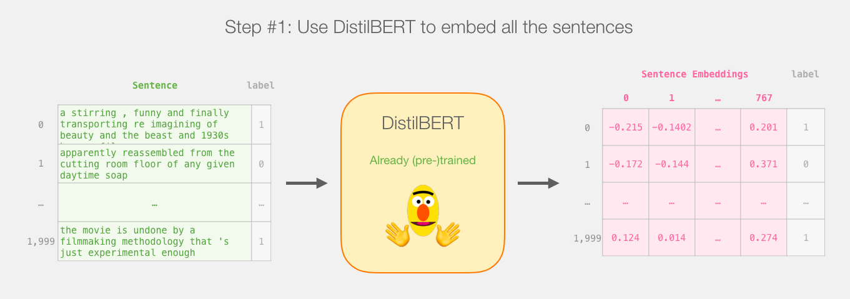
Step # 1 Use distilBERT to Generate Sentence Embeddings
Source: Jay Alammar (2019), A Visual Guide to Using BERT for the First Time, http://jalammar.github.io/a-visual-guide-to-using-bert-for-the-first-time/

Slide 49
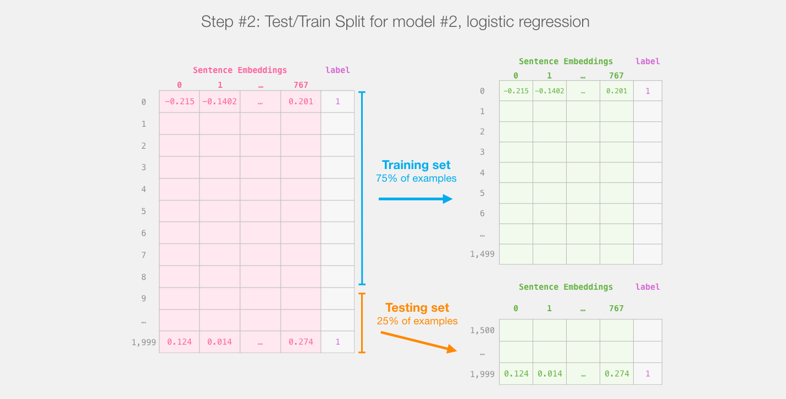
Step #2:Test/Train Split for Model #2, Logistic Regression
Source: Jay Alammar (2019), A Visual Guide to Using BERT for the First Time, http://jalammar.github.io/a-visual-guide-to-using-bert-for-the-first-time/

Slide 50
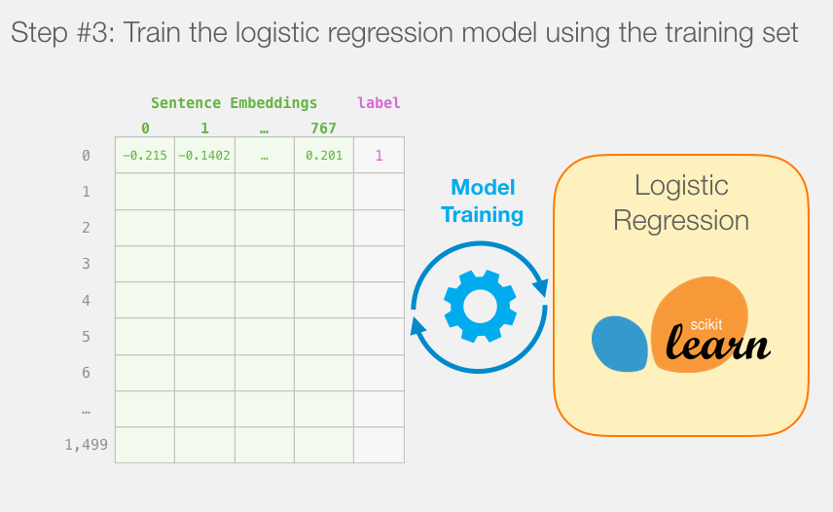
Step #3 Train the logistic regression model using the training set
Source: Jay Alammar (2019), A Visual Guide to Using BERT for the First Time, http://jalammar.github.io/a-visual-guide-to-using-bert-for-the-first-time/

Slide 51
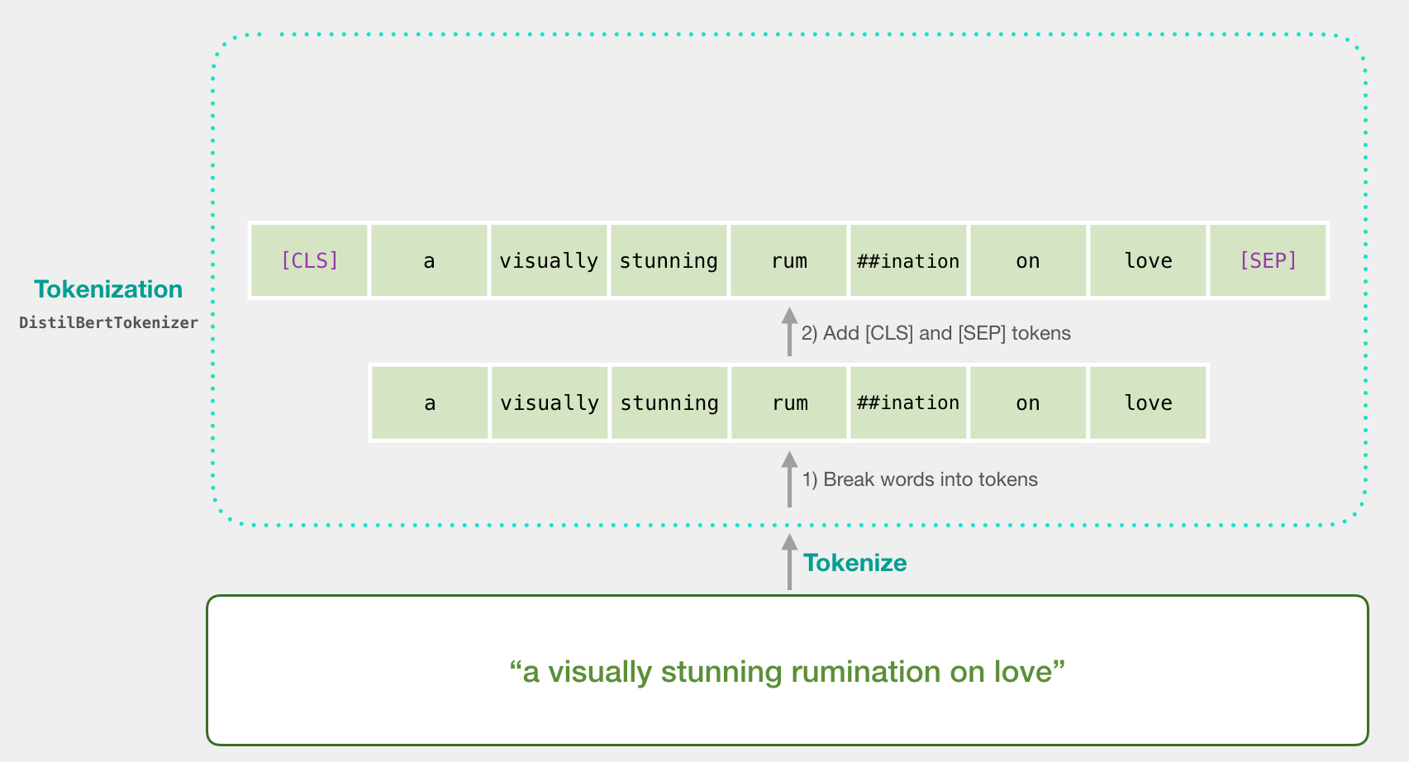
Tokenization
[CLS] a visually stunning rum ##ination on love [SEP]
a visually stunning rumination on love
Source: Jay Alammar (2019), A Visual Guide to Using BERT for the First Time, http://jalammar.github.io/a-visual-guide-to-using-bert-for-the-first-time/

Slide 52
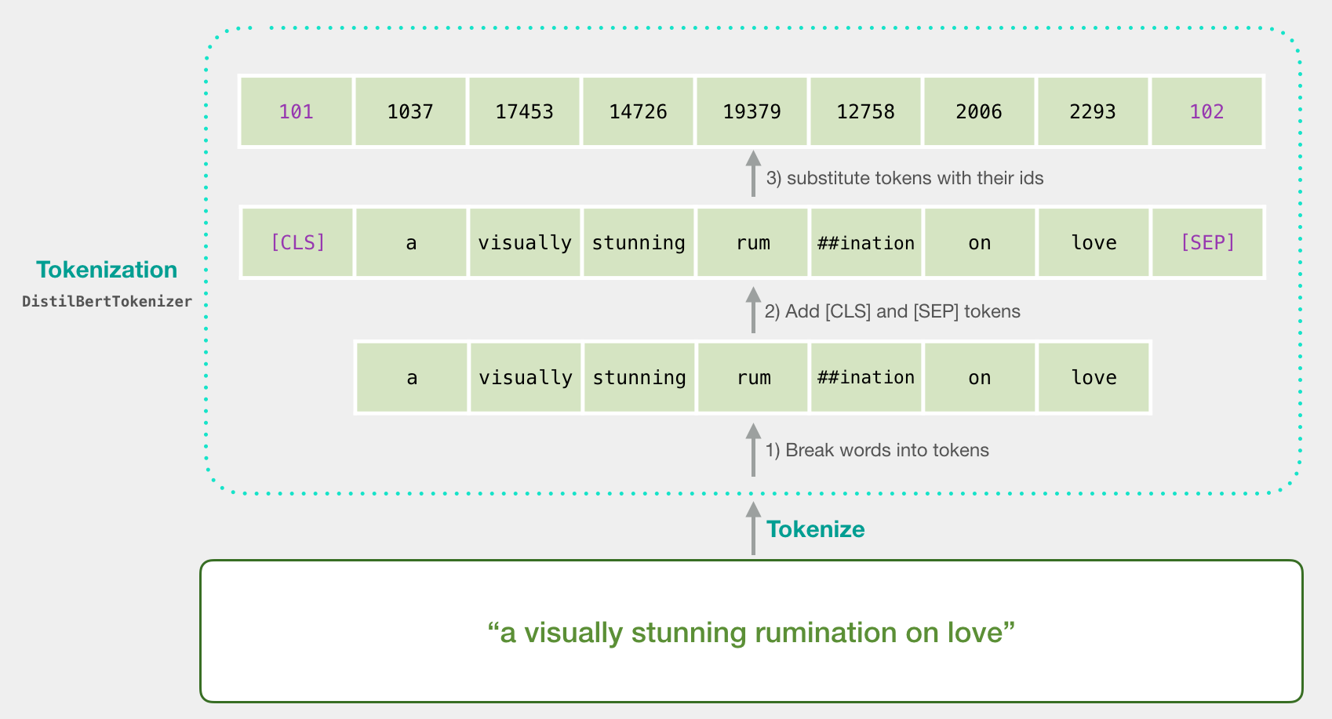
Tokenization
tokenizer.encode("a visually stunning rumination on love", add_special_tokens=True)
Source: Jay Alammar (2019), A Visual Guide to Using BERT for the First Time, http://jalammar.github.io/a-visual-guide-to-using-bert-for-the-first-time/

Slide 53
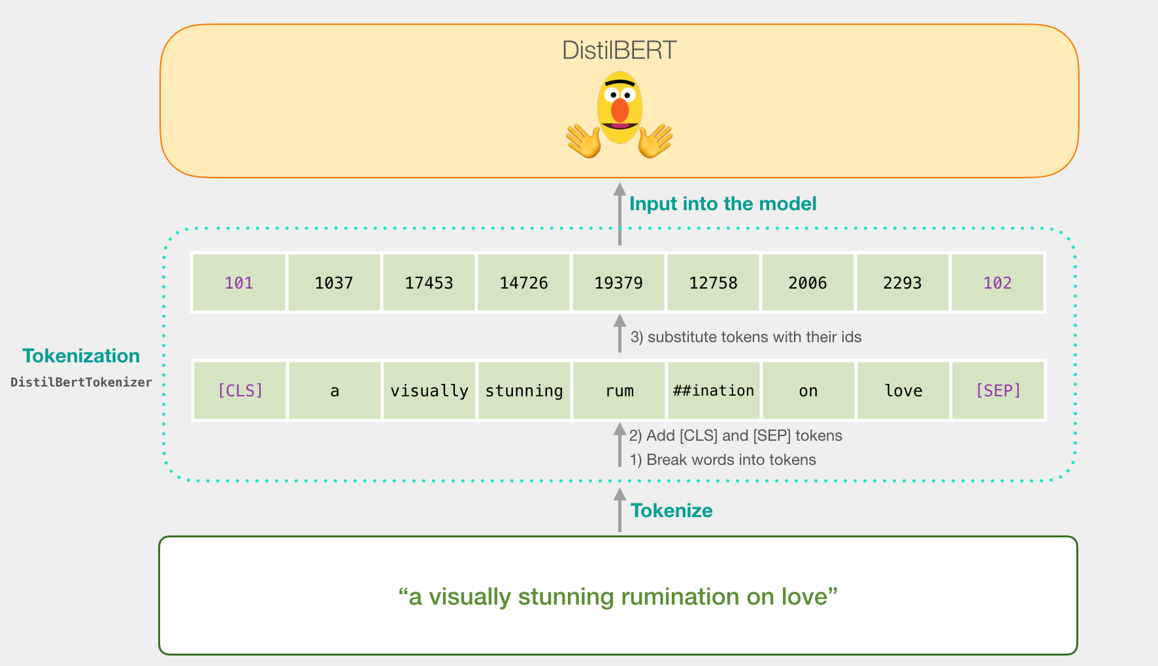
Tokenization for BERT Model
Source: Jay Alammar (2019), A Visual Guide to Using BERT for the First Time, http://jalammar.github.io/a-visual-guide-to-using-bert-for-the-first-time/

Slide 54
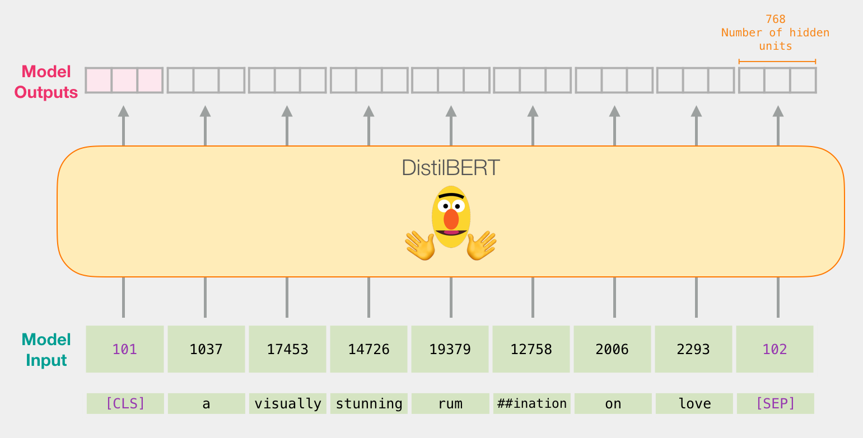
Flowing Through DistilBERT (768 features)
Source: Jay Alammar (2019), A Visual Guide to Using BERT for the First Time, http://jalammar.github.io/a-visual-guide-to-using-bert-for-the-first-time/

Slide 55
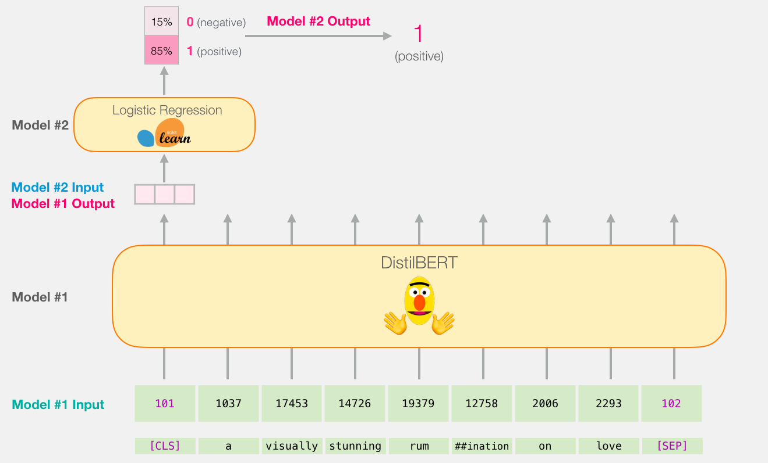
Model #1 Output Class vector as Model #2 Input
Source: Jay Alammar (2019), A Visual Guide to Using BERT for the First Time, http://jalammar.github.io/a-visual-guide-to-using-bert-for-the-first-time/

Slide 56
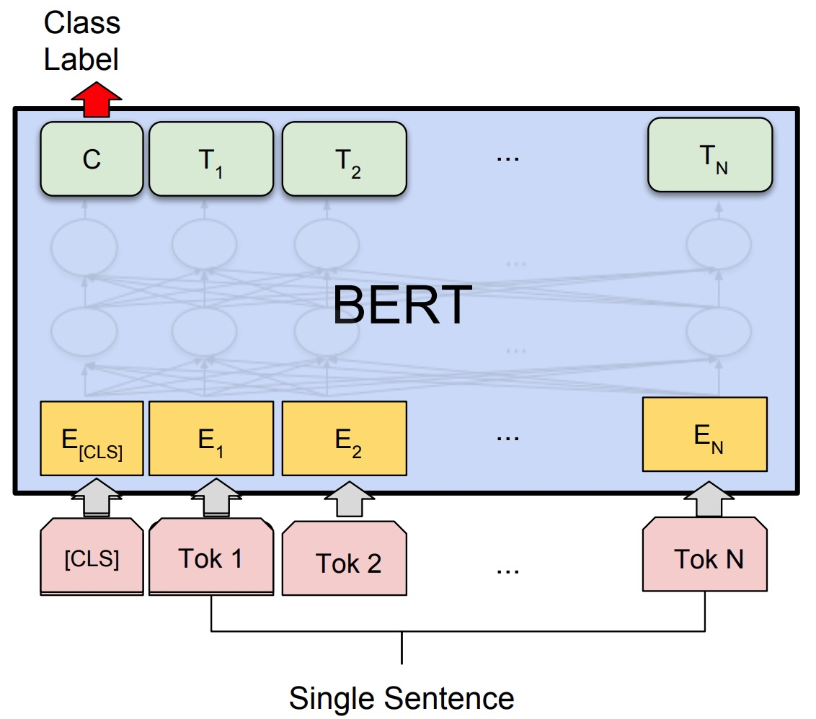
Fine-tuning BERT on Single Sentence Classification Tasks
Source: Devlin, Jacob, Ming-Wei Chang, Kenton Lee, and Kristina Toutanova (2018). "Bert: Pre-training of deep bidirectional transformers for language understanding." arXiv preprint arXiv:1810.04805.

Slide 57
Model #1 Output Class vector as Model #2 Input
Source: Jay Alammar (2019), A Visual Guide to Using BERT for the First Time, http://jalammar.github.io/a-visual-guide-to-using-bert-for-the-first-time/

Slide 58
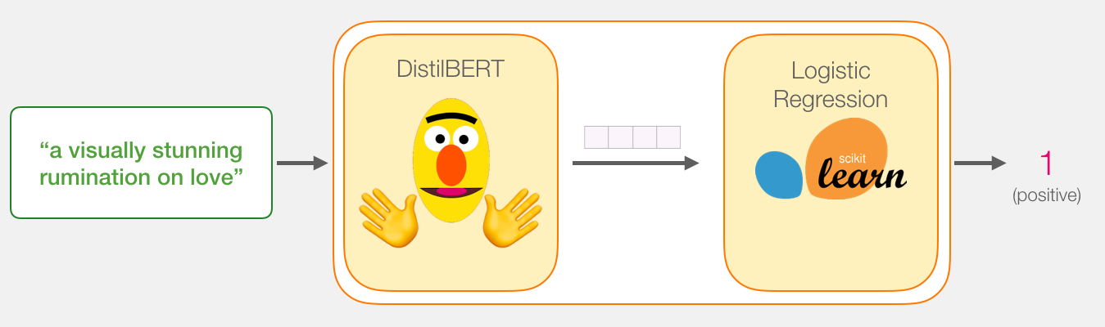
Logistic Regression Model to classify Class vector
Source: Jay Alammar (2019), A Visual Guide to Using BERT for the First Time, http://jalammar.github.io/a-visual-guide-to-using-bert-for-the-first-time/

Slide 59
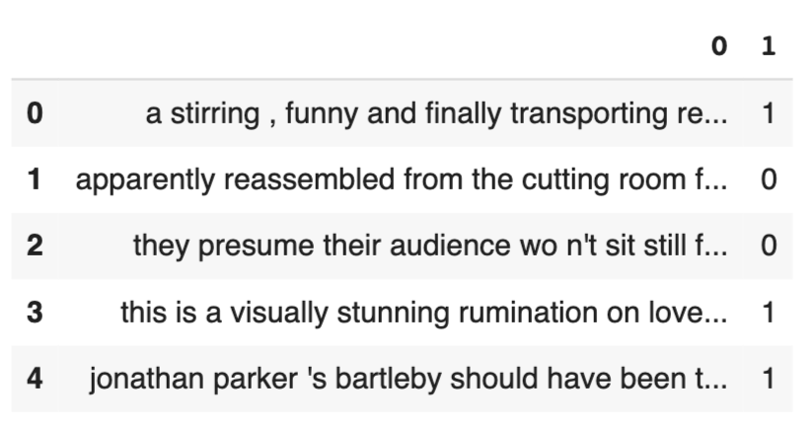
df = pd.read_csv('https://github.com/clairett/pytorch-sentiment-classification/raw/master/data/SST2/train.tsv', delimiter='\t', header=None)
df.head()
Source: Jay Alammar (2019), A Visual Guide to Using BERT for the First Time, http://jalammar.github.io/a-visual-guide-to-using-bert-for-the-first-time/

Slide 60
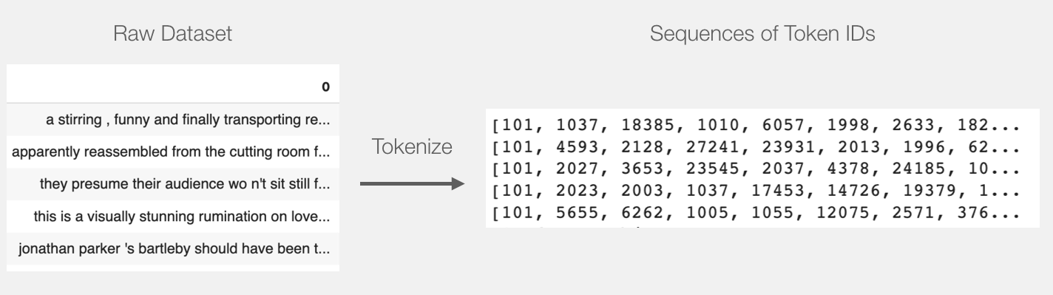
Tokenization
tokenized = df[0].apply((lambda x: tokenizer.encode(x, add_special_tokens=True)))
Source: Jay Alammar (2019), A Visual Guide to Using BERT for the First Time, http://jalammar.github.io/a-visual-guide-to-using-bert-for-the-first-time/

Slide 61
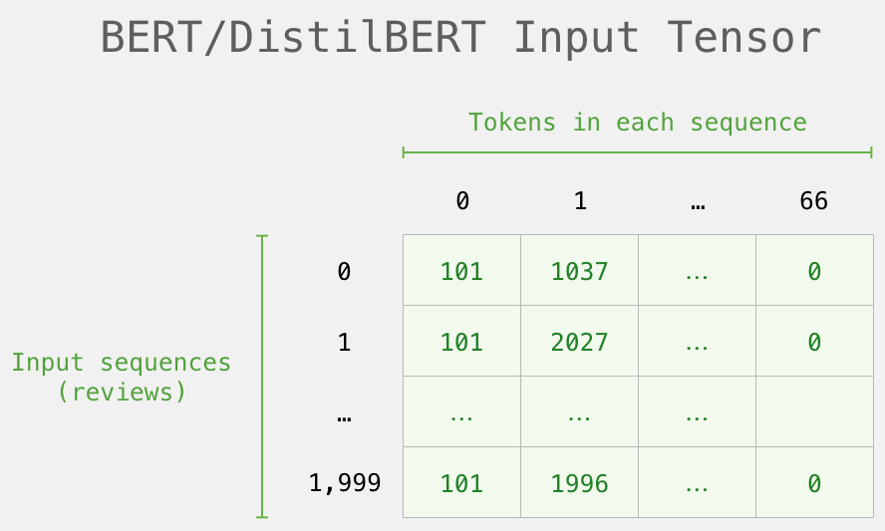
BERT Input Tensor
Source: Jay Alammar (2019), A Visual Guide to Using BERT for the First Time, http://jalammar.github.io/a-visual-guide-to-using-bert-for-the-first-time/

Slide 62
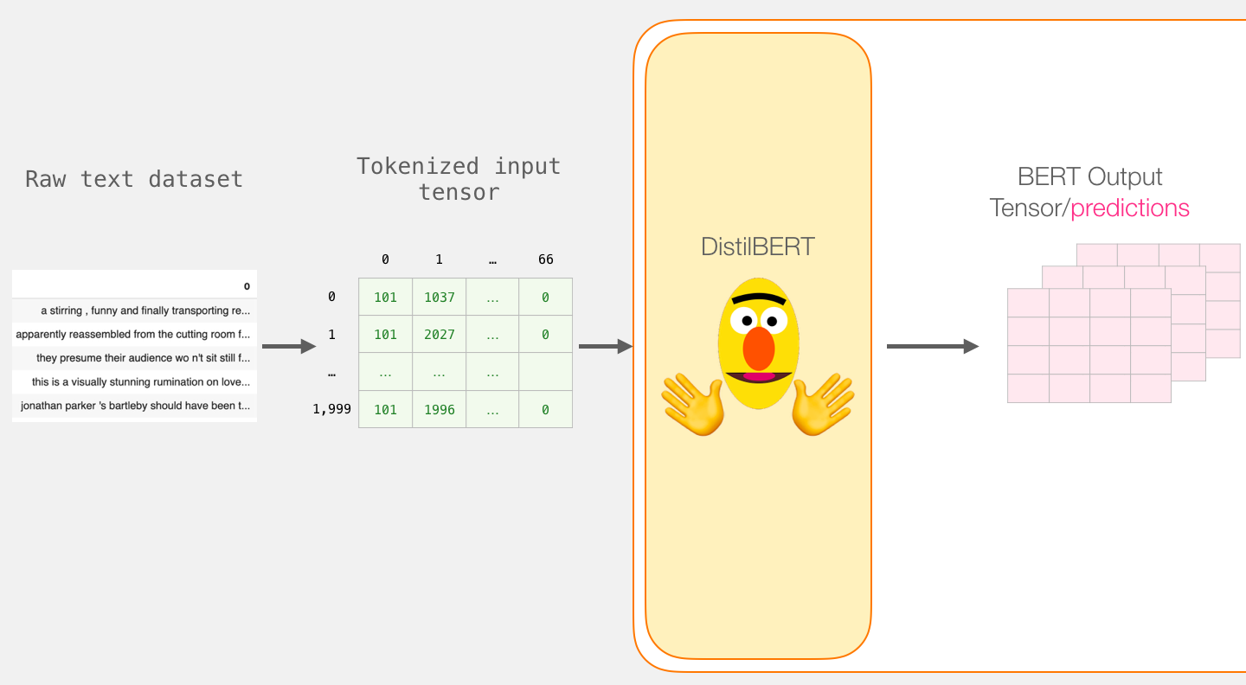
Processing with DistilBERT
input_ids = torch.tensor(np.array(padded))
last_hidden_states = model(input_ids)
Source: Jay Alammar (2019), A Visual Guide to Using BERT for the First Time, http://jalammar.github.io/a-visual-guide-to-using-bert-for-the-first-time/

Slide 63
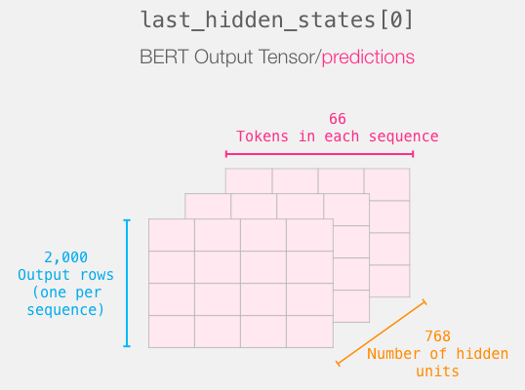
Unpacking the BERT output tensor
Source: Jay Alammar (2019), A Visual Guide to Using BERT for the First Time, http://jalammar.github.io/a-visual-guide-to-using-bert-for-the-first-time/

Slide 64
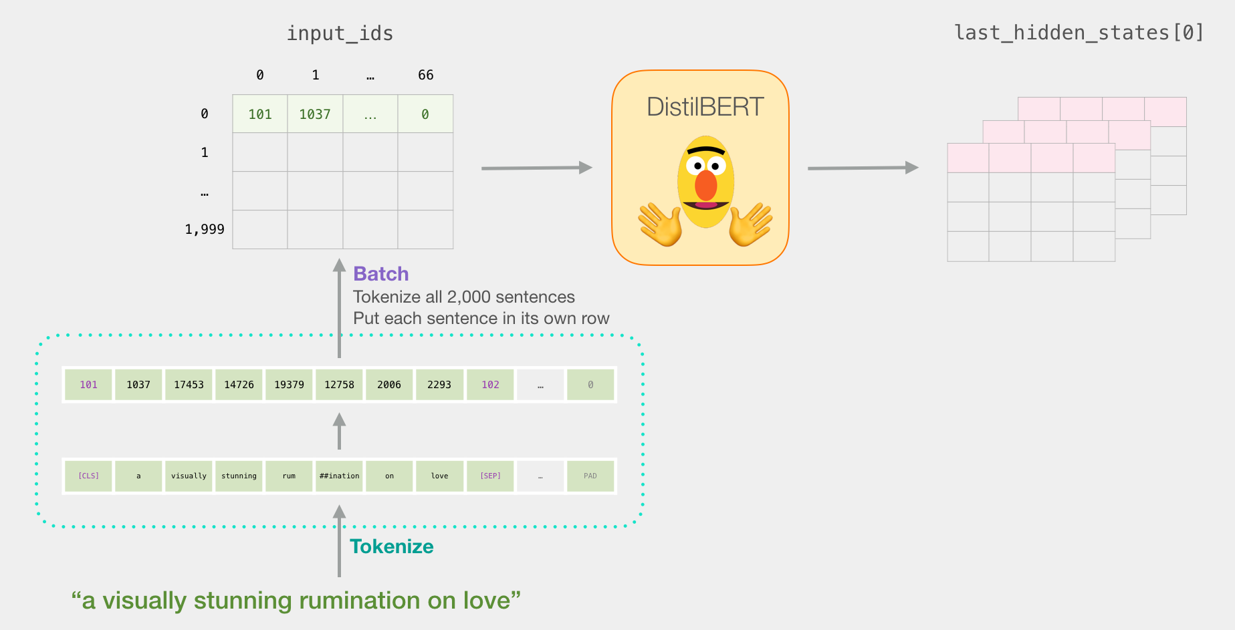
Sentence to last_hidden_state[0]
Source: Jay Alammar (2019), A Visual Guide to Using BERT for the First Time, http://jalammar.github.io/a-visual-guide-to-using-bert-for-the-first-time/

Slide 65
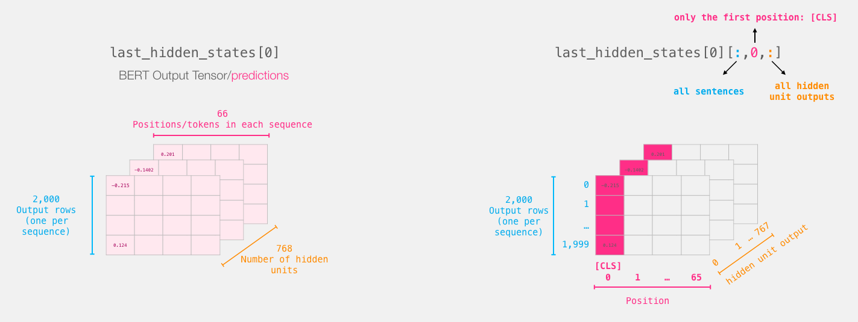
BERT’s output for the [CLS] tokens
# Slice the output for the first position for all the sequences, take all hidden unit outputs
features = last_hidden_states[0][:,0,:].numpy()
Source: Jay Alammar (2019), A Visual Guide to Using BERT for the First Time, http://jalammar.github.io/a-visual-guide-to-using-bert-for-the-first-time/

Slide 66
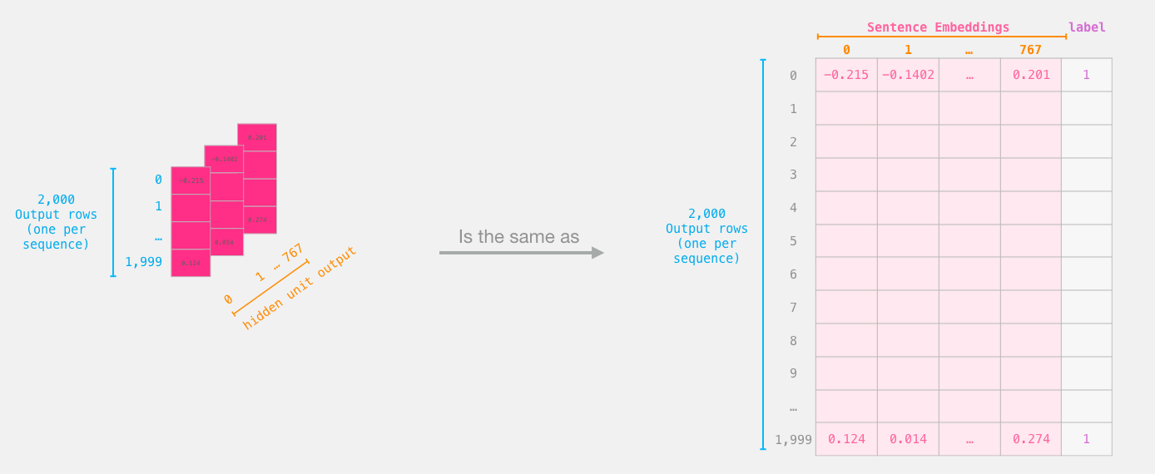
The tensor sliced from BERT's output Sentence Embeddings
Source: Jay Alammar (2019), A Visual Guide to Using BERT for the First Time, http://jalammar.github.io/a-visual-guide-to-using-bert-for-the-first-time/

Slide 67
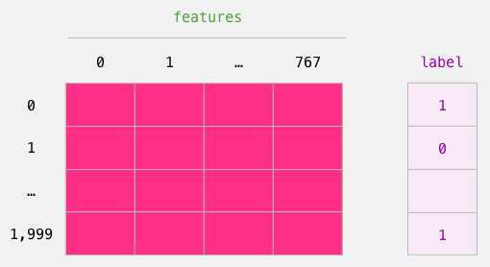
Dataset for Logistic Regression (768 Features)
The features are the output vectors of BERT for the [CLS] token (position #0)
Source: Jay Alammar (2019), A Visual Guide to Using BERT for the First Time, http://jalammar.github.io/a-visual-guide-to-using-bert-for-the-first-time/

Slide 68
labels = df[1]
train_features, test_features, train_labels, test_labels = train_test_split(features, labels)
Source: Jay Alammar (2019), A Visual Guide to Using BERT for the First Time, http://jalammar.github.io/a-visual-guide-to-using-bert-for-the-first-time/

Slide 69
Score Benchmarks Logistic Regression Model on SST-2 Dataset
# Training
lr_clf = LogisticRegression()
lr_clf.fit(train_features, train_labels)
#Testing
lr_clf.score(test_features, test_labels)
# Accuracy: 81%
# Highest accuracy: 96.8%
# Fine-tuned DistilBERT: 90.7%
# Full size BERT model: 94.9%
Source: Jay Alammar (2019), A Visual Guide to Using BERT for the First Time, http://jalammar.github.io/a-visual-guide-to-using-bert-for-the-first-time/

Slide 70
Sentiment Classification: SST2 Sentences from movie reviews
sentence | label
a stirring , funny and finally transporting re imagining of beauty and the beast and 1930s horror films | 1
apparently reassembled from the cutting room floor of any given daytime soap | 0
they presume their audience won't sit still for a sociology lesson | 0
this is a visually stunning rumination on love , memory , history and the war between art and commerce | 1
jonathan parker 's bartleby should have been the be all end all of the modern office anomie films | 1
Source: Jay Alammar (2019), A Visual Guide to Using BERT for the First Time, http://jalammar.github.io/a-visual-guide-to-using-bert-for-the-first-time/

Slide 71
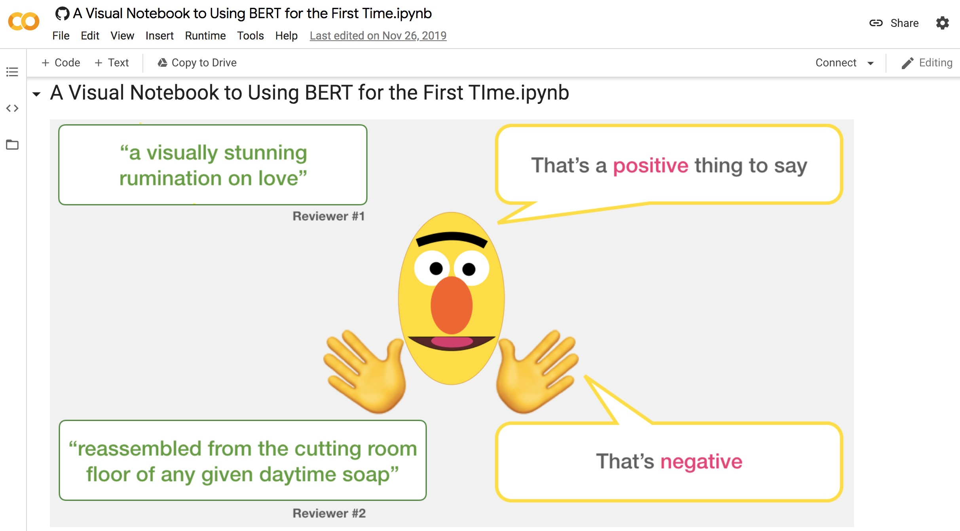
A Visual Notebook to Using BERT for the First Time
https://colab.research.google.com/github/jalammar/jalammar.github.io/blob/master/notebooks/bert/A_Visual_Notebook_to_Using_BERT_for_the_First_Time.ipynb

Slide 72
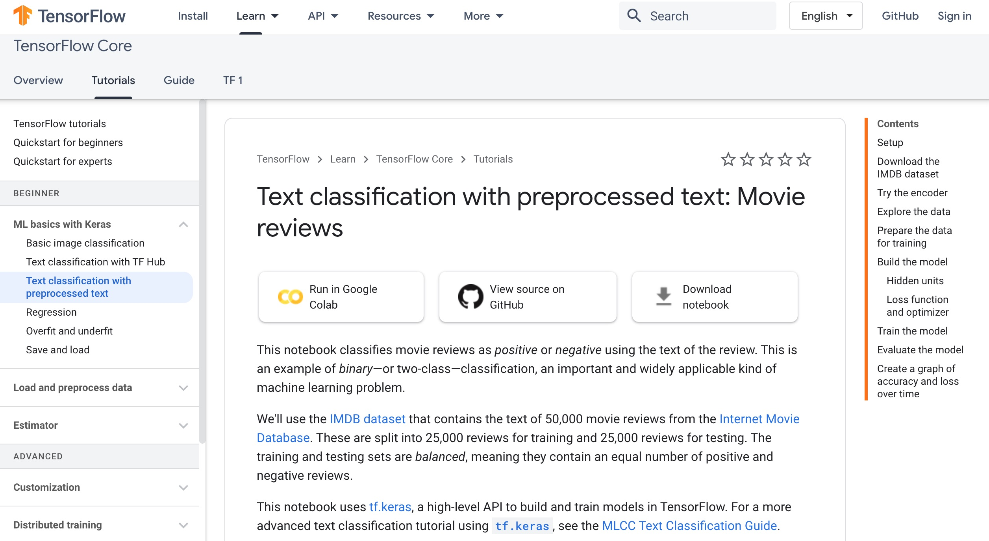
Text classification with preprocessed text: Movie reviews
https://www.tensorflow.org/tutorials/keras/text_classification

Slide 73
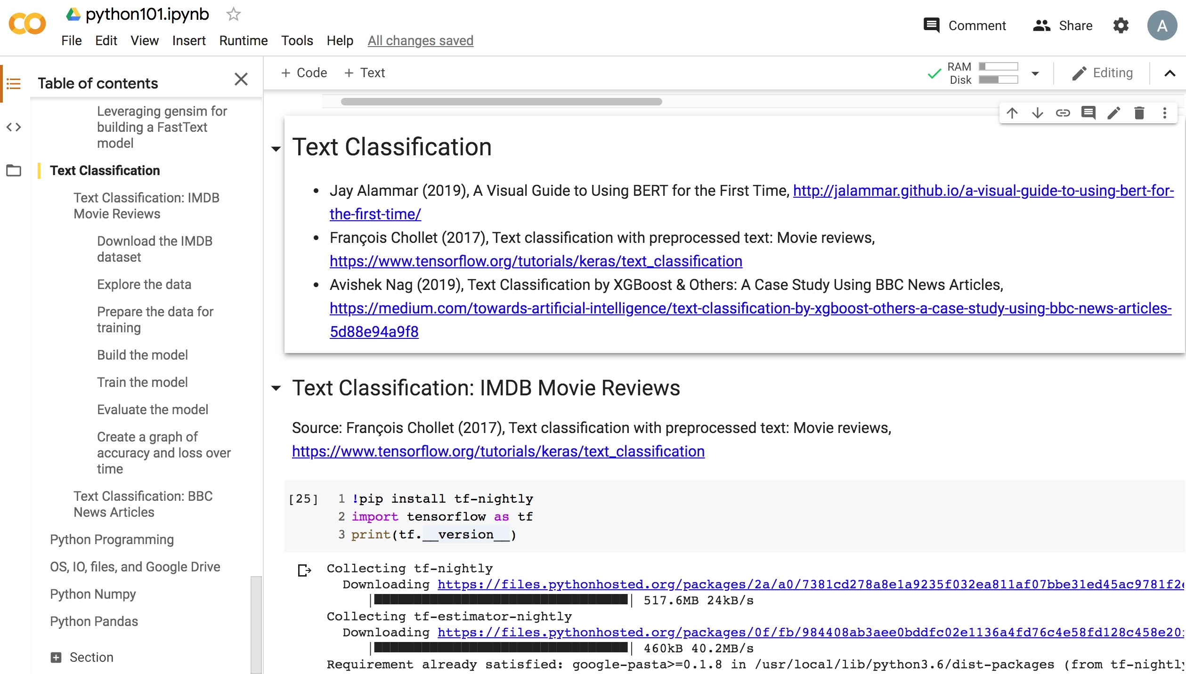
Python in Google Colab (Python101)
https://colab.research.google.com/drive/1FEG6DnGvwfUbeo4zJ1zTunjMqf2RkCrT
https://tinyurl.com/aintpupython101

Slide 74

Python in Google Colab (Python101)
https://colab.research.google.com/drive/1FEG6DnGvwfUbeo4zJ1zTunjMqf2RkCrT
https://tinyurl.com/aintpupython101

Slide 75
Summary
AI for Text Analytics: Foundations
Processing and Understanding Text
AI for Text Analytics: Application
Sentiment Analysis
Text classification

Slide 76
References
Ramesh Sharda, Dursun Delen, and Efraim Turban (2017), Business Intelligence, Analytics, and Data Science: A Managerial Perspective, 4th Edition, Pearson.
Dipanjan Sarkar (2019), Text Analytics with Python: A Practitioner’s Guide to Natural Language Processing, Second Edition. APress.
Benjamin Bengfort, Rebecca Bilbro, and Tony Ojeda (2018), Applied Text Analysis with Python: Enabling Language-Aware Data Products with Machine Learning, O’Reilly.
Gabe Ignatow and Rada F. Mihalcea (2017), An Introduction to Text Mining: Research Design, Data Collection, and Analysis, SAGE Publications.
Rajesh Arumugam (2018), Hands-On Natural Language Processing with Python: A practical guide to applying deep learning architectures to your NLP applications, Packt.
Devlin, Jacob, Ming-Wei Chang, Kenton Lee, and Kristina Toutanova (2018). "BERT: Pre-training of Deep Bidirectional Transformers for Language Understanding." arXiv preprint arXiv:1810.04805.
Steven Bird, Ewan Klein and Edward Loper (2009), Natural Language Processing with Python, O'Reilly Media, http://www.nltk.org/book/ , http://www.nltk.org/book_1ed/
Jay Alammar (2019), A Visual Guide to Using BERT for the First Time, http://jalammar.github.io/a-visual-guide-to-using-bert-for-the-first-time/
François Chollet (2017), Text classification with preprocessed text: Movie reviews, https://www.tensorflow.org/tutorials/keras/text_classification
Google Developers (2020), Machine Learning Guides: Text Classification, https://developers.google.com/machine-learning/guides/text-classification
Avishek Nag (2019), Text Classification by XGBoost & Others: A Case Study Using BBC News Articles, https://medium.com/towards-artificial-intelligence/text-classification-by-xgboost-others-a-case-study-using-bbc-news-articles-5d88e94a9f8
The Super Duper NLP Repo, https://notebooks.quantumstat.com/
Min-Yuh Day (2020), Python 101, https://tinyurl.com/aintpupython101

Slide 77
Q & A
人工智慧文本分析 基礎與應用 (Artificial Intelligence for Text Analytics: Foundations and Applications)
Min-Yuh Day
戴敏育
Associate Professor
副教授
Institute of Information Management, National Taipei University
國立臺北大學 資訊管理研究所
https://web.ntpu.edu.tw/~myday
2020-09-26

